Slide 1
St. Louis Central Corridor West Building Permits Yearly Report
2019

Slide 2
Introduction
Data retreived from https://www.stlouis-mo.gov/data/
Building permits with a cost of $0 were dropped
Building permits that were cancelled were dropped

Slide 3
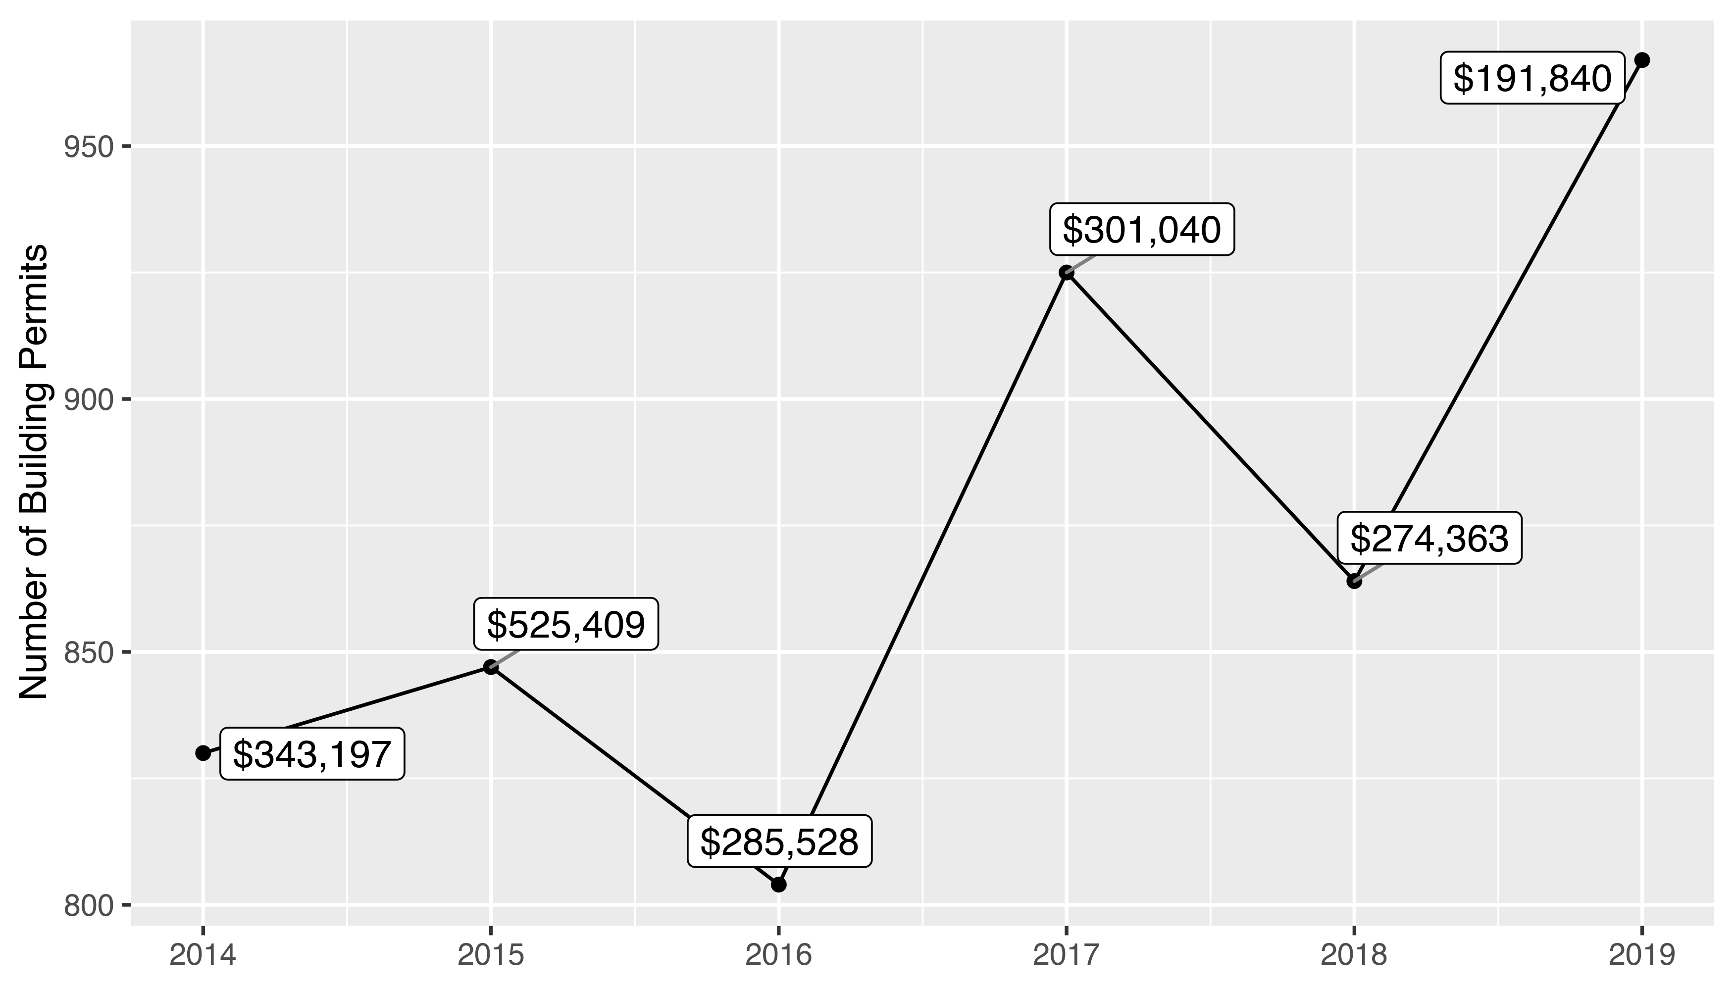
5 Year Analysis

Slide 4
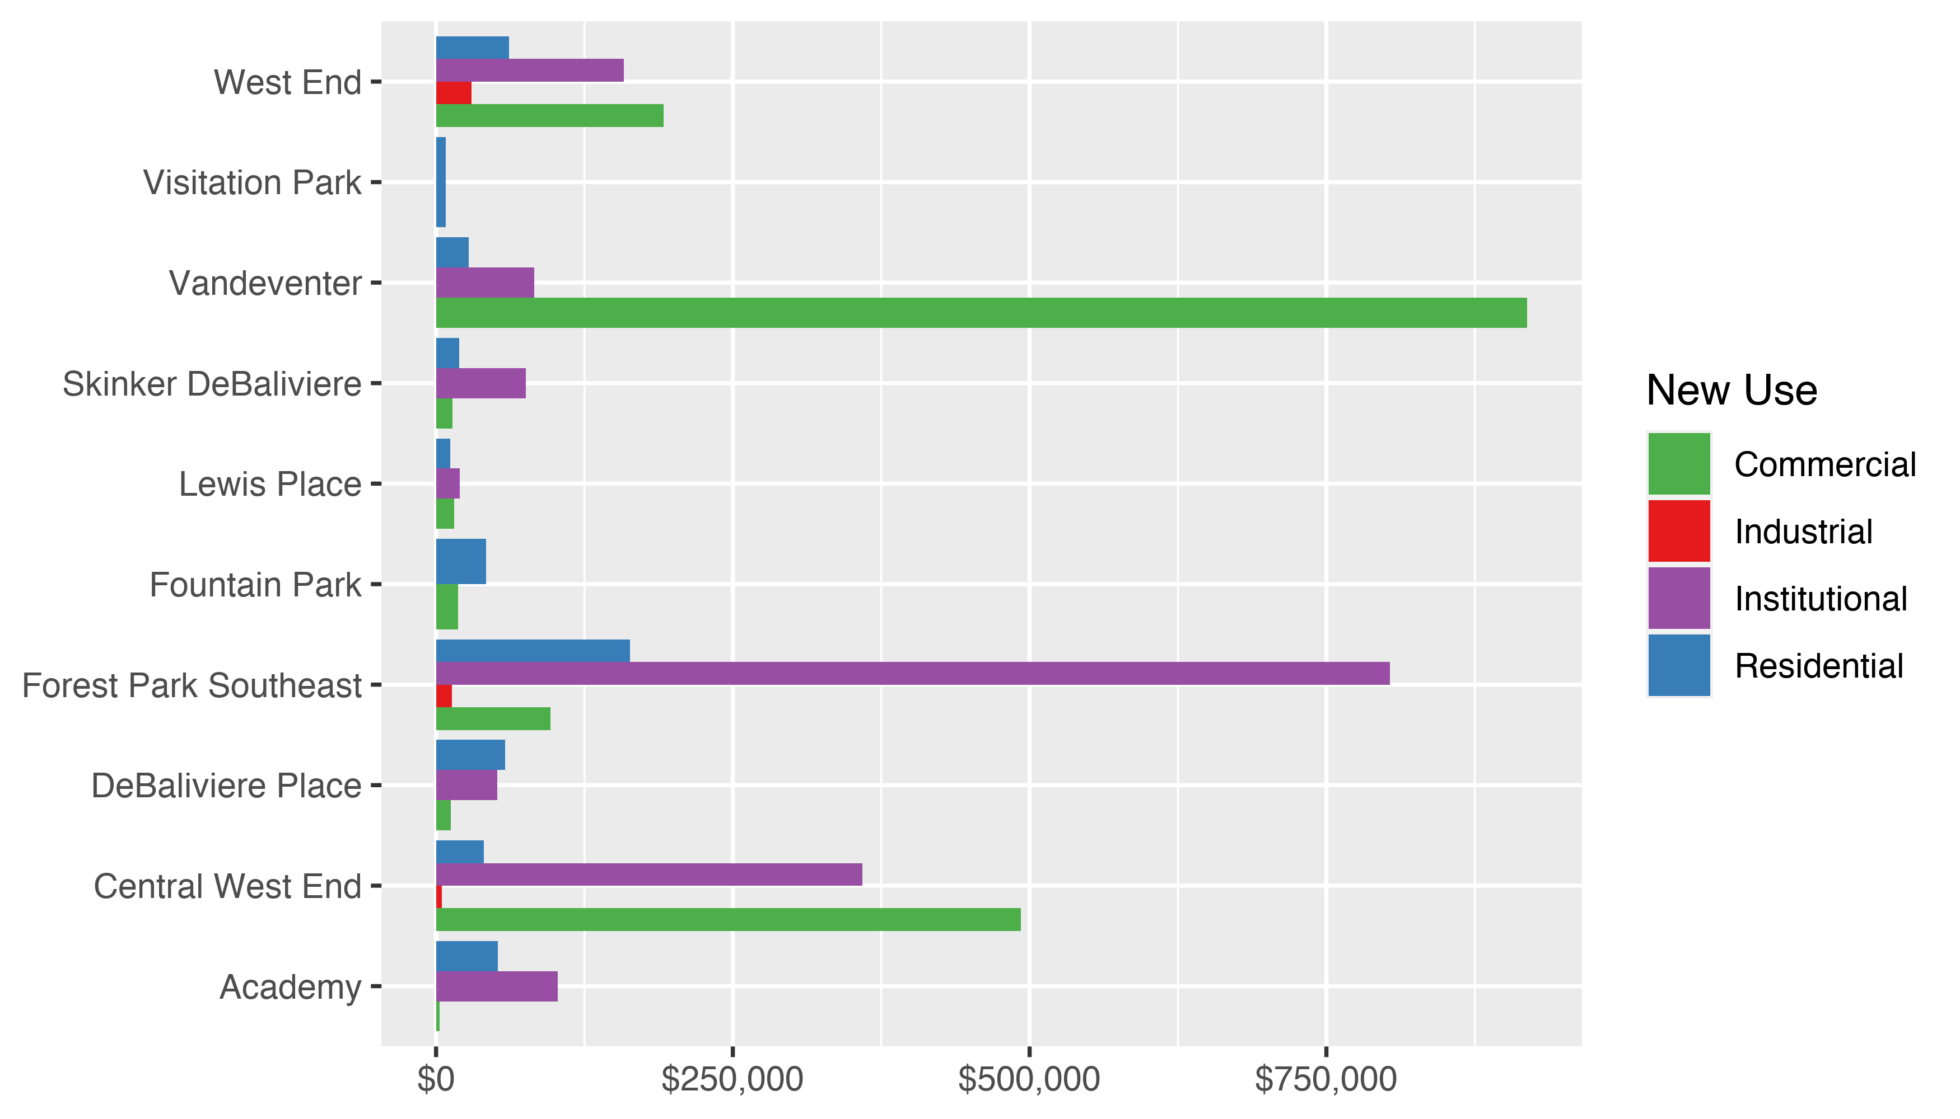
Neighborhood Summary: Average Building Permit Cost

Slide 5
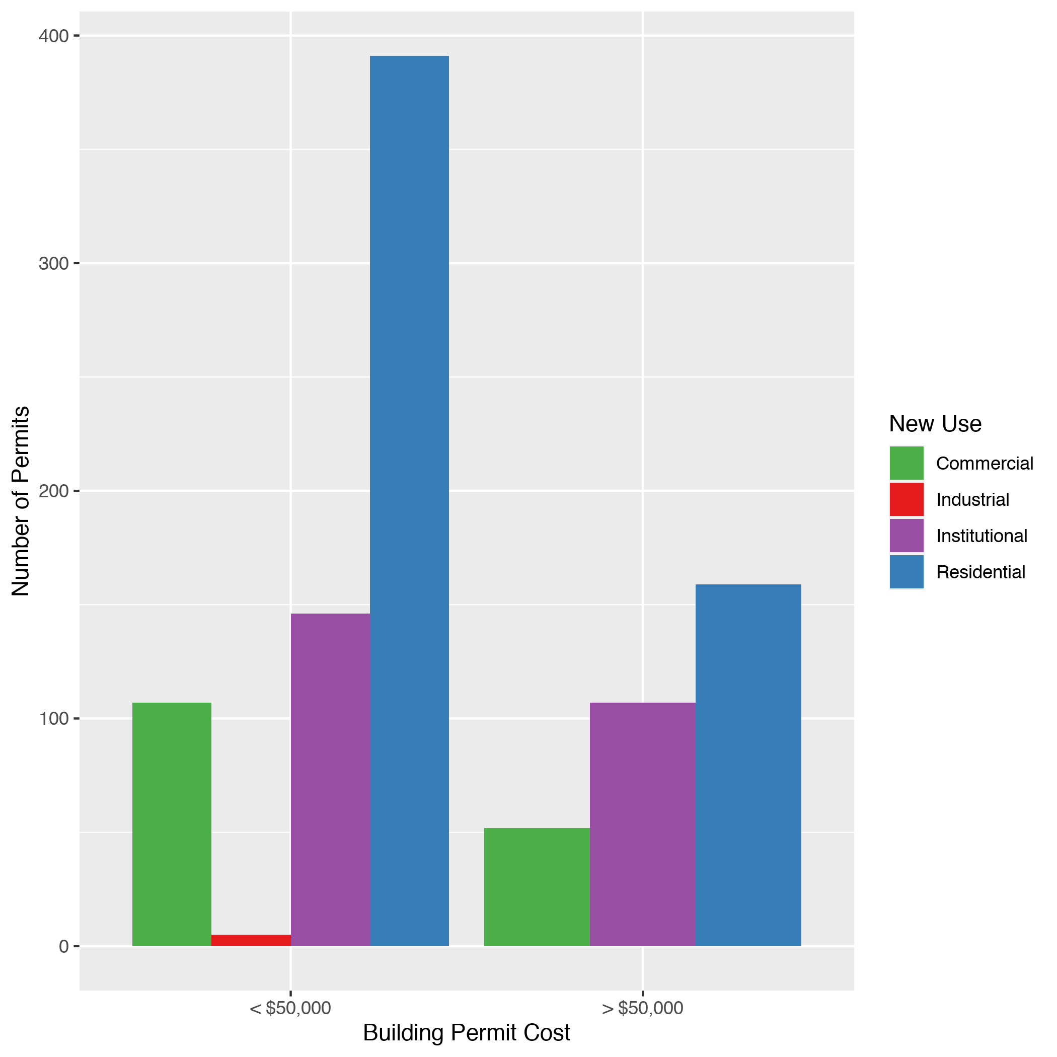
Neighborhood Summary: Average Building Permit Cost

Slide 6
Neighborhood Summary
Neighborhood | Average Cost | # of Permits
Academy | $52,109 | 38
Central West End | $253,878 | 503
DeBaliviere Place | $56,553 | 60
Forest Park Southeast | $232,668 | 177
Fountain Park | $35,651 | 11
Lewis Place | $13,260 | 10
Skinker DeBaliviere | $21,078 | 75
Vandeventer | $111,850 | 33
Visitation Park | $8,000 | 1
West End | $92,349 | 59

Slide 7
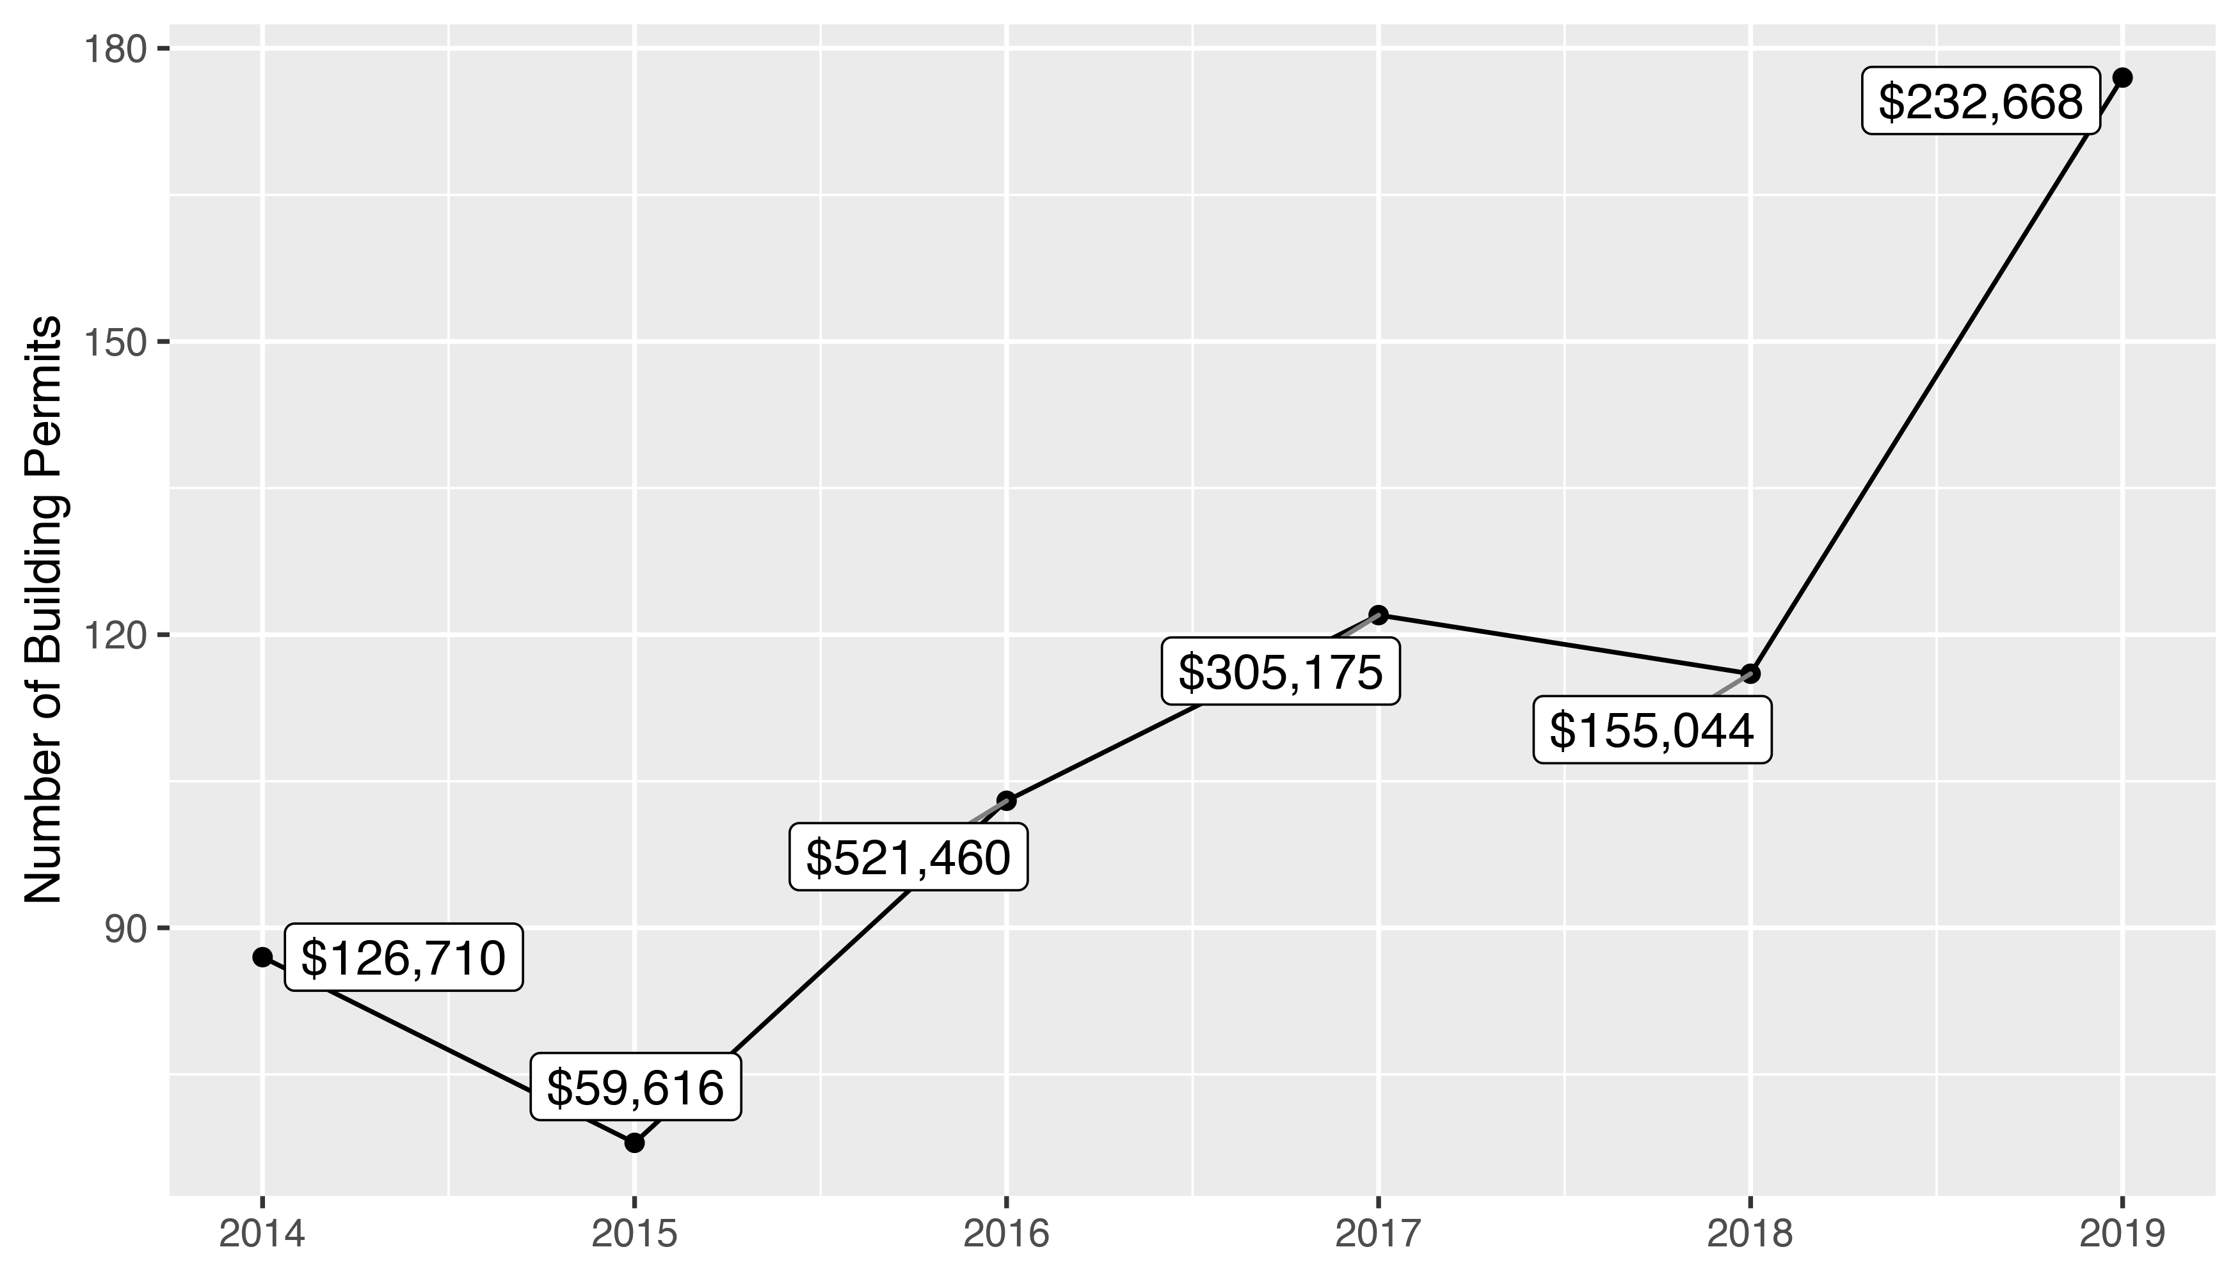
Forest Park Southeast 5 Year Analysis

Slide 8
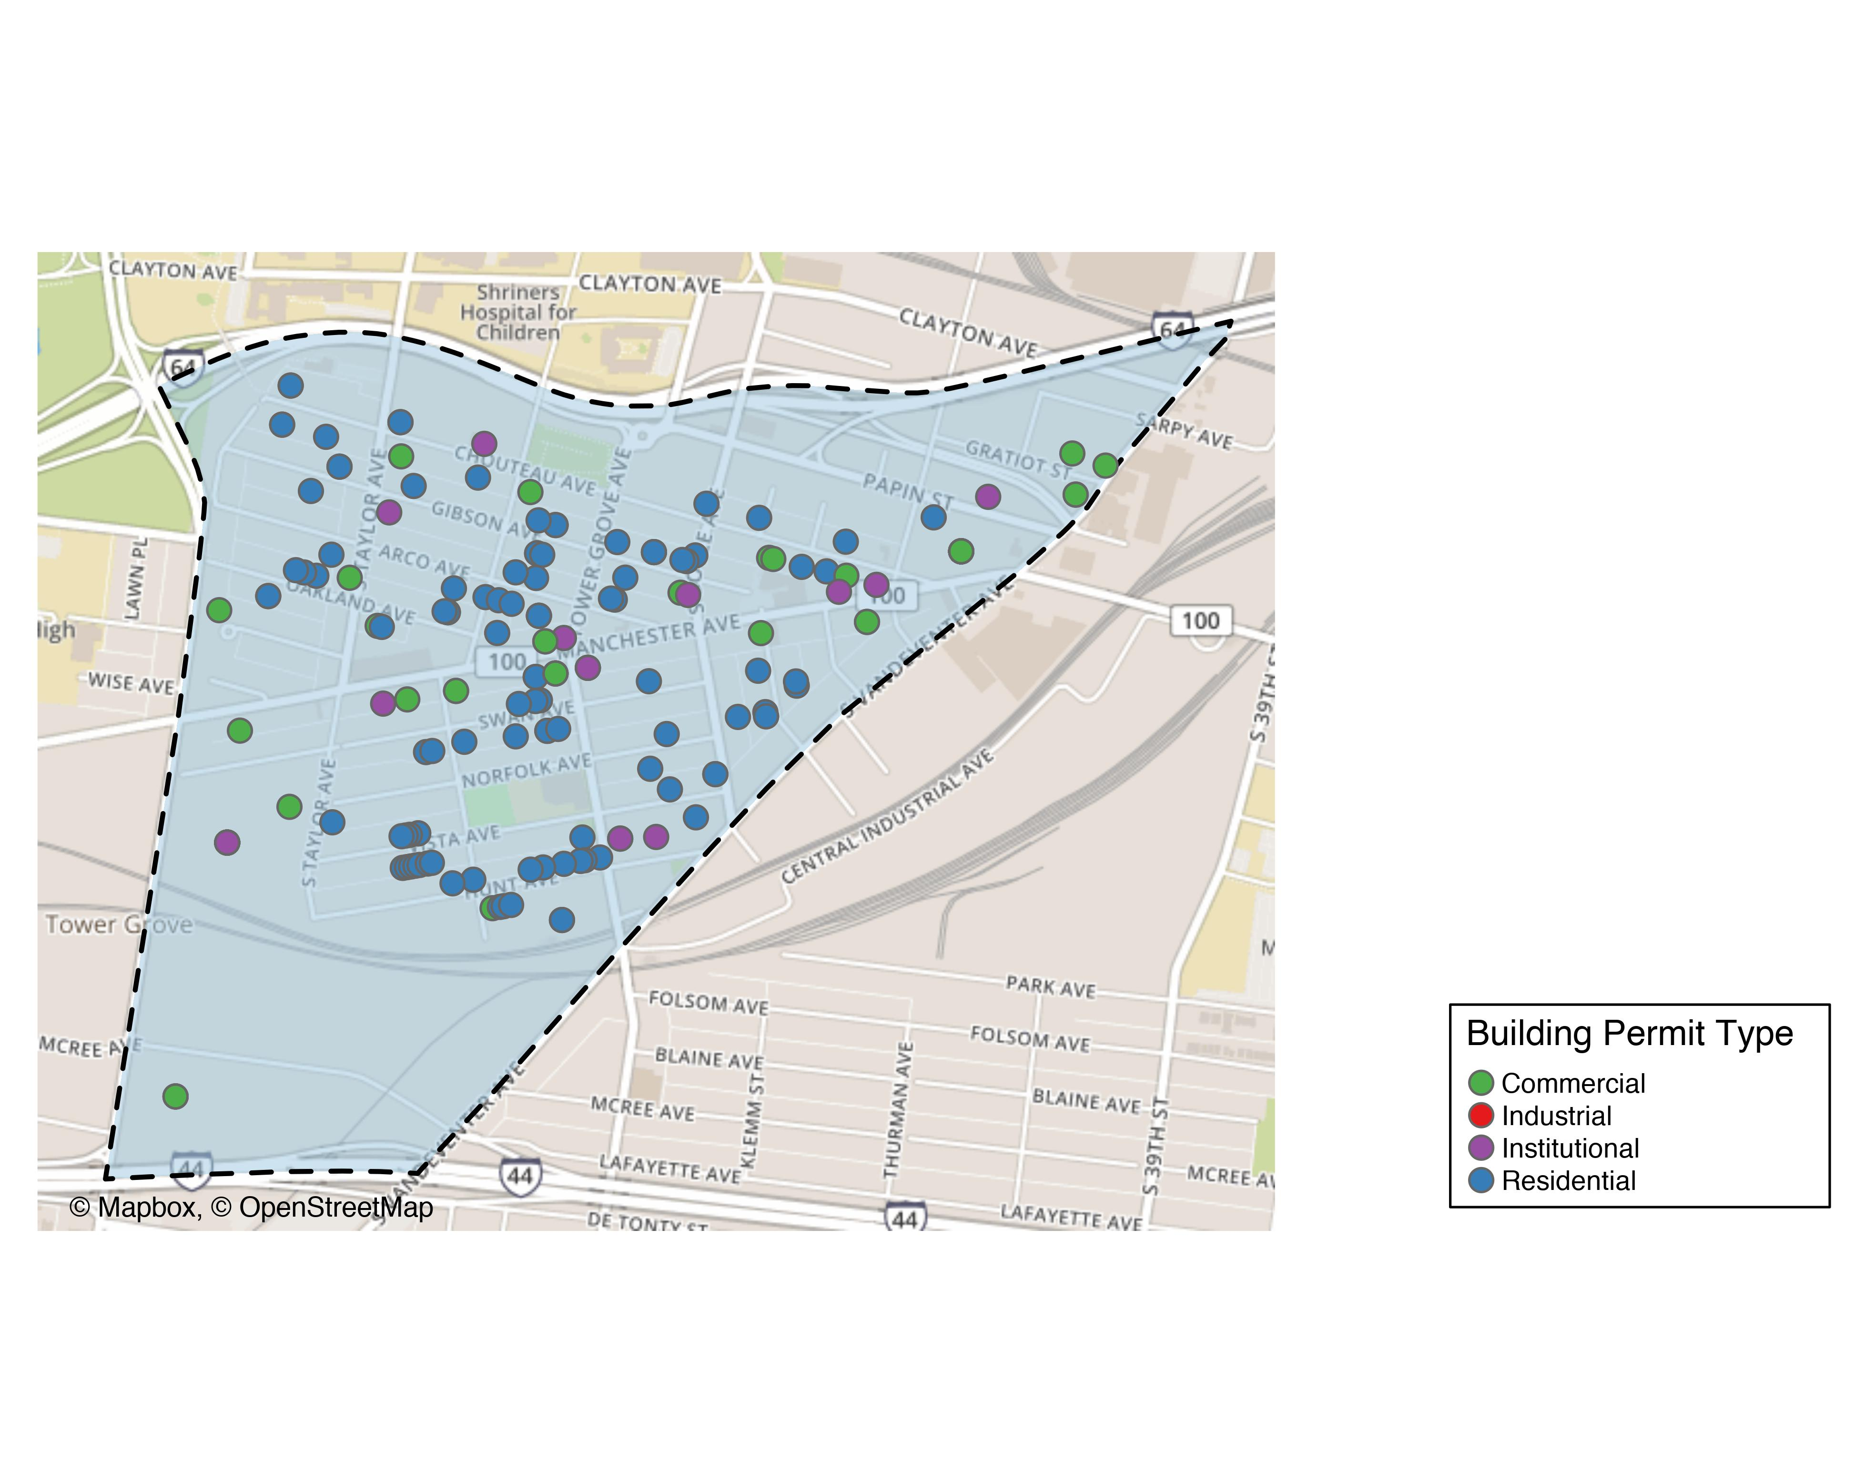
Forest Park Southeast

Slide 9
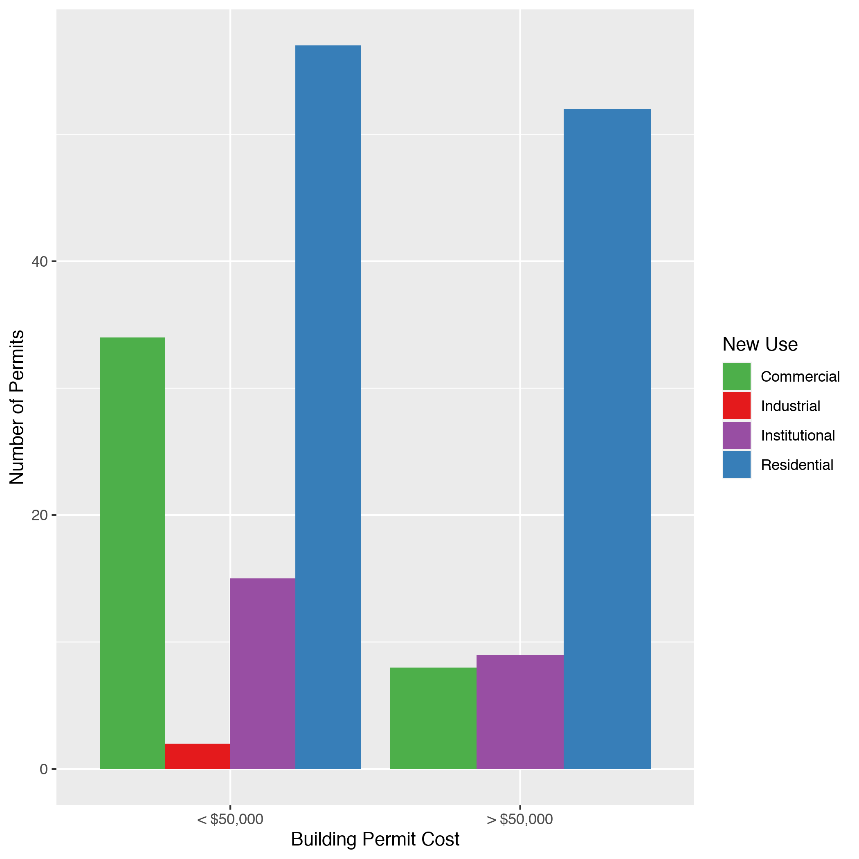
Forest Park Southeast
New Use | Average Cost | # of Permits
Commercial | $96,412 | 42
Industrial | $13,500 | 2
Institutional | $803,731 | 24
Residential | $163,453 | 109

Slide 10
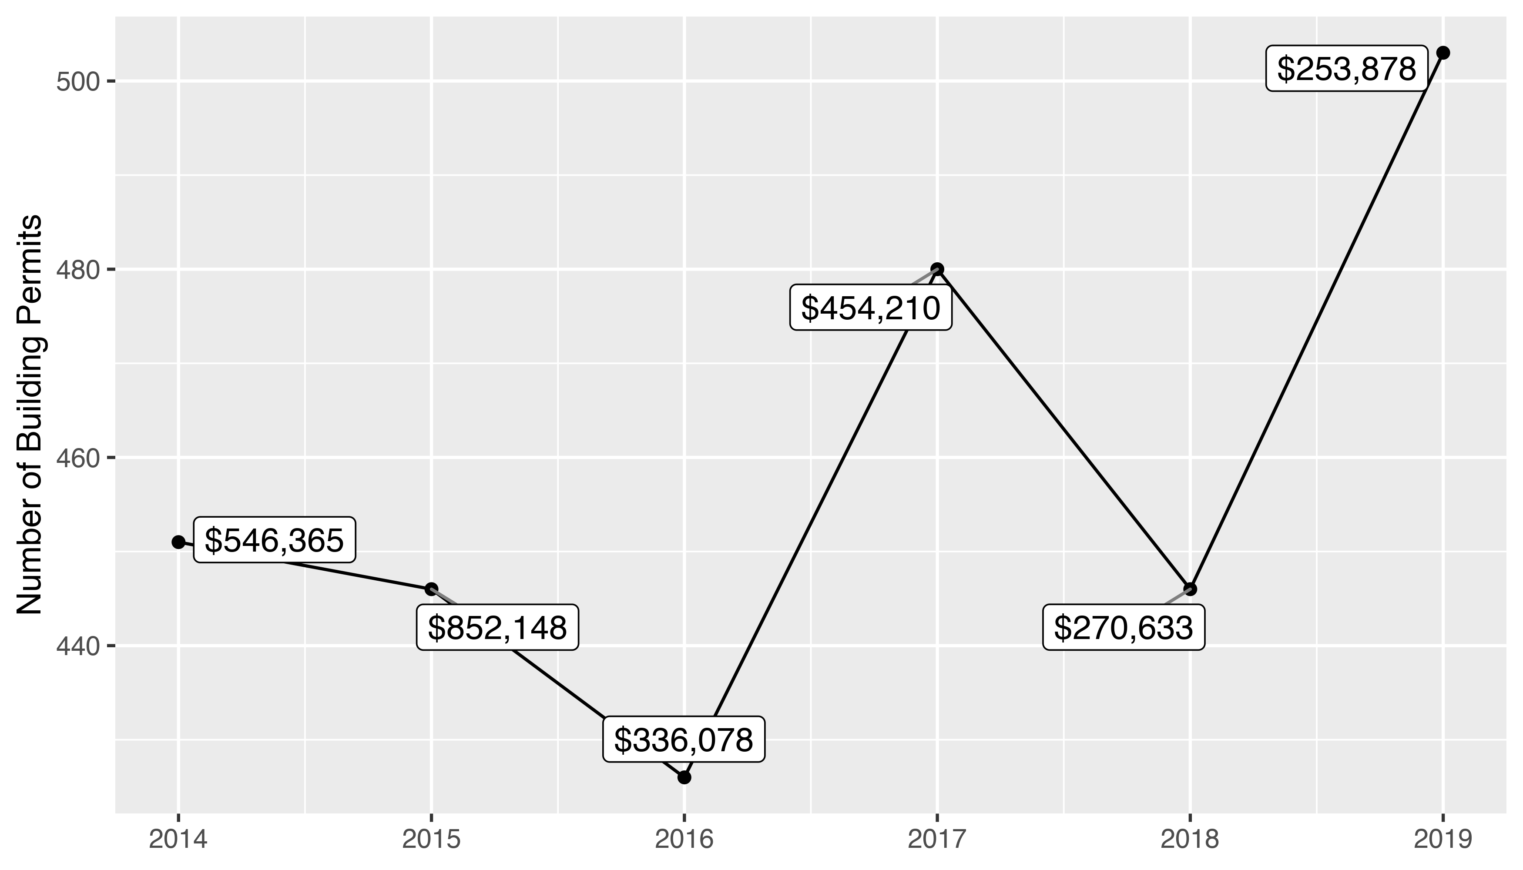
Central West End 5 Year Analysis

Slide 11
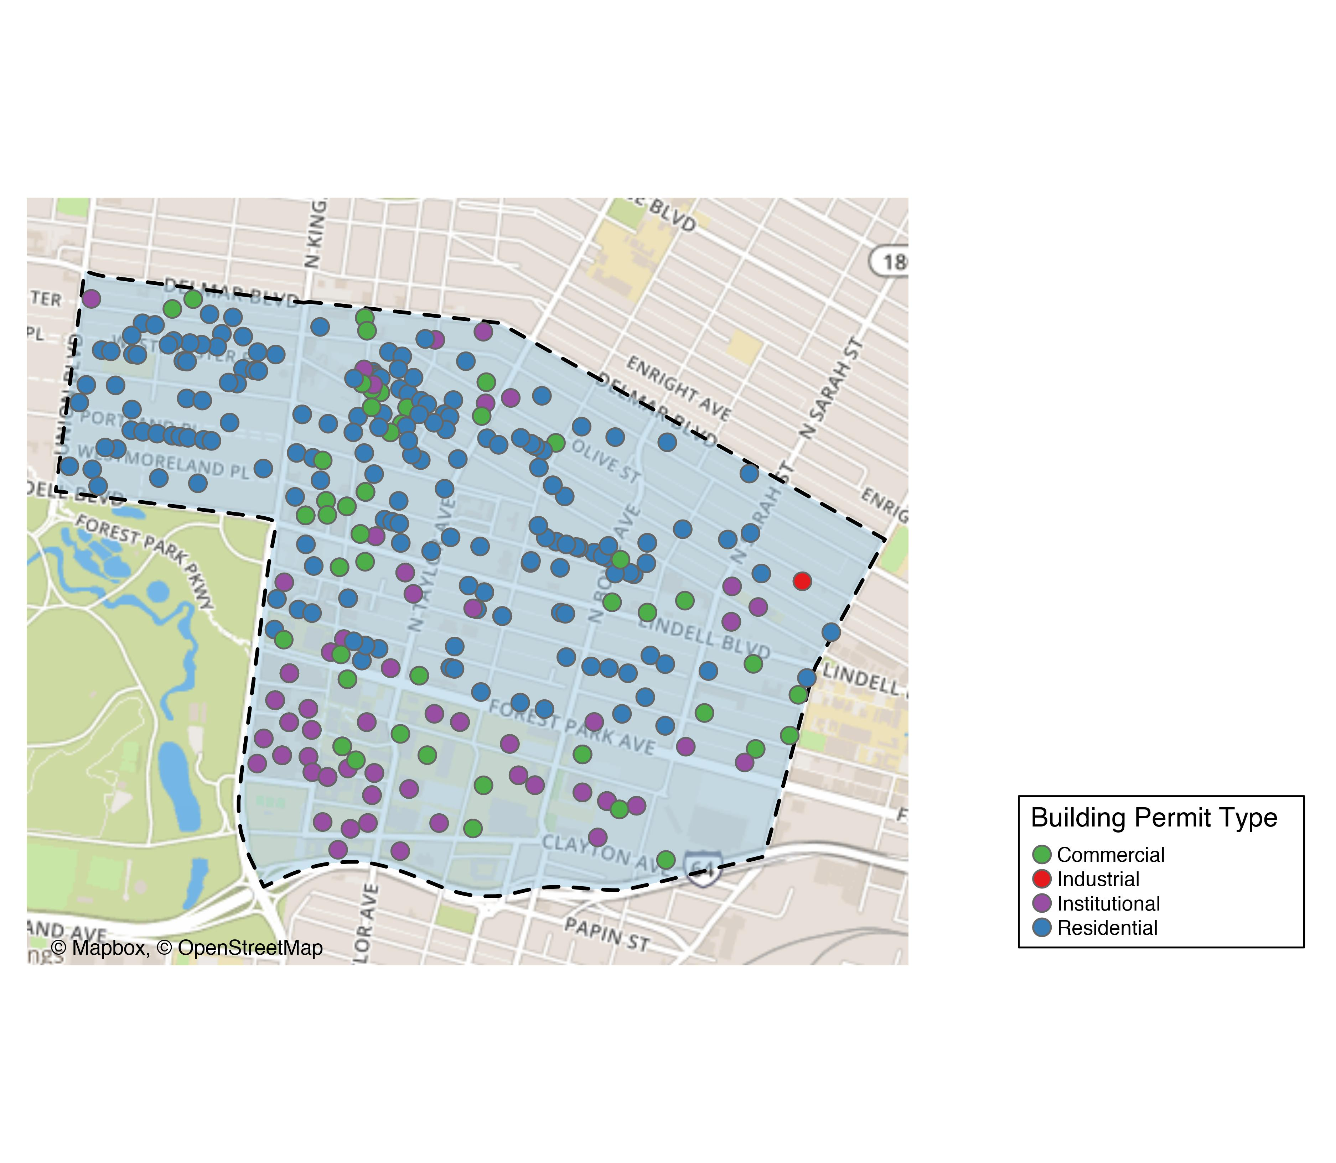
Central West End

Slide 12
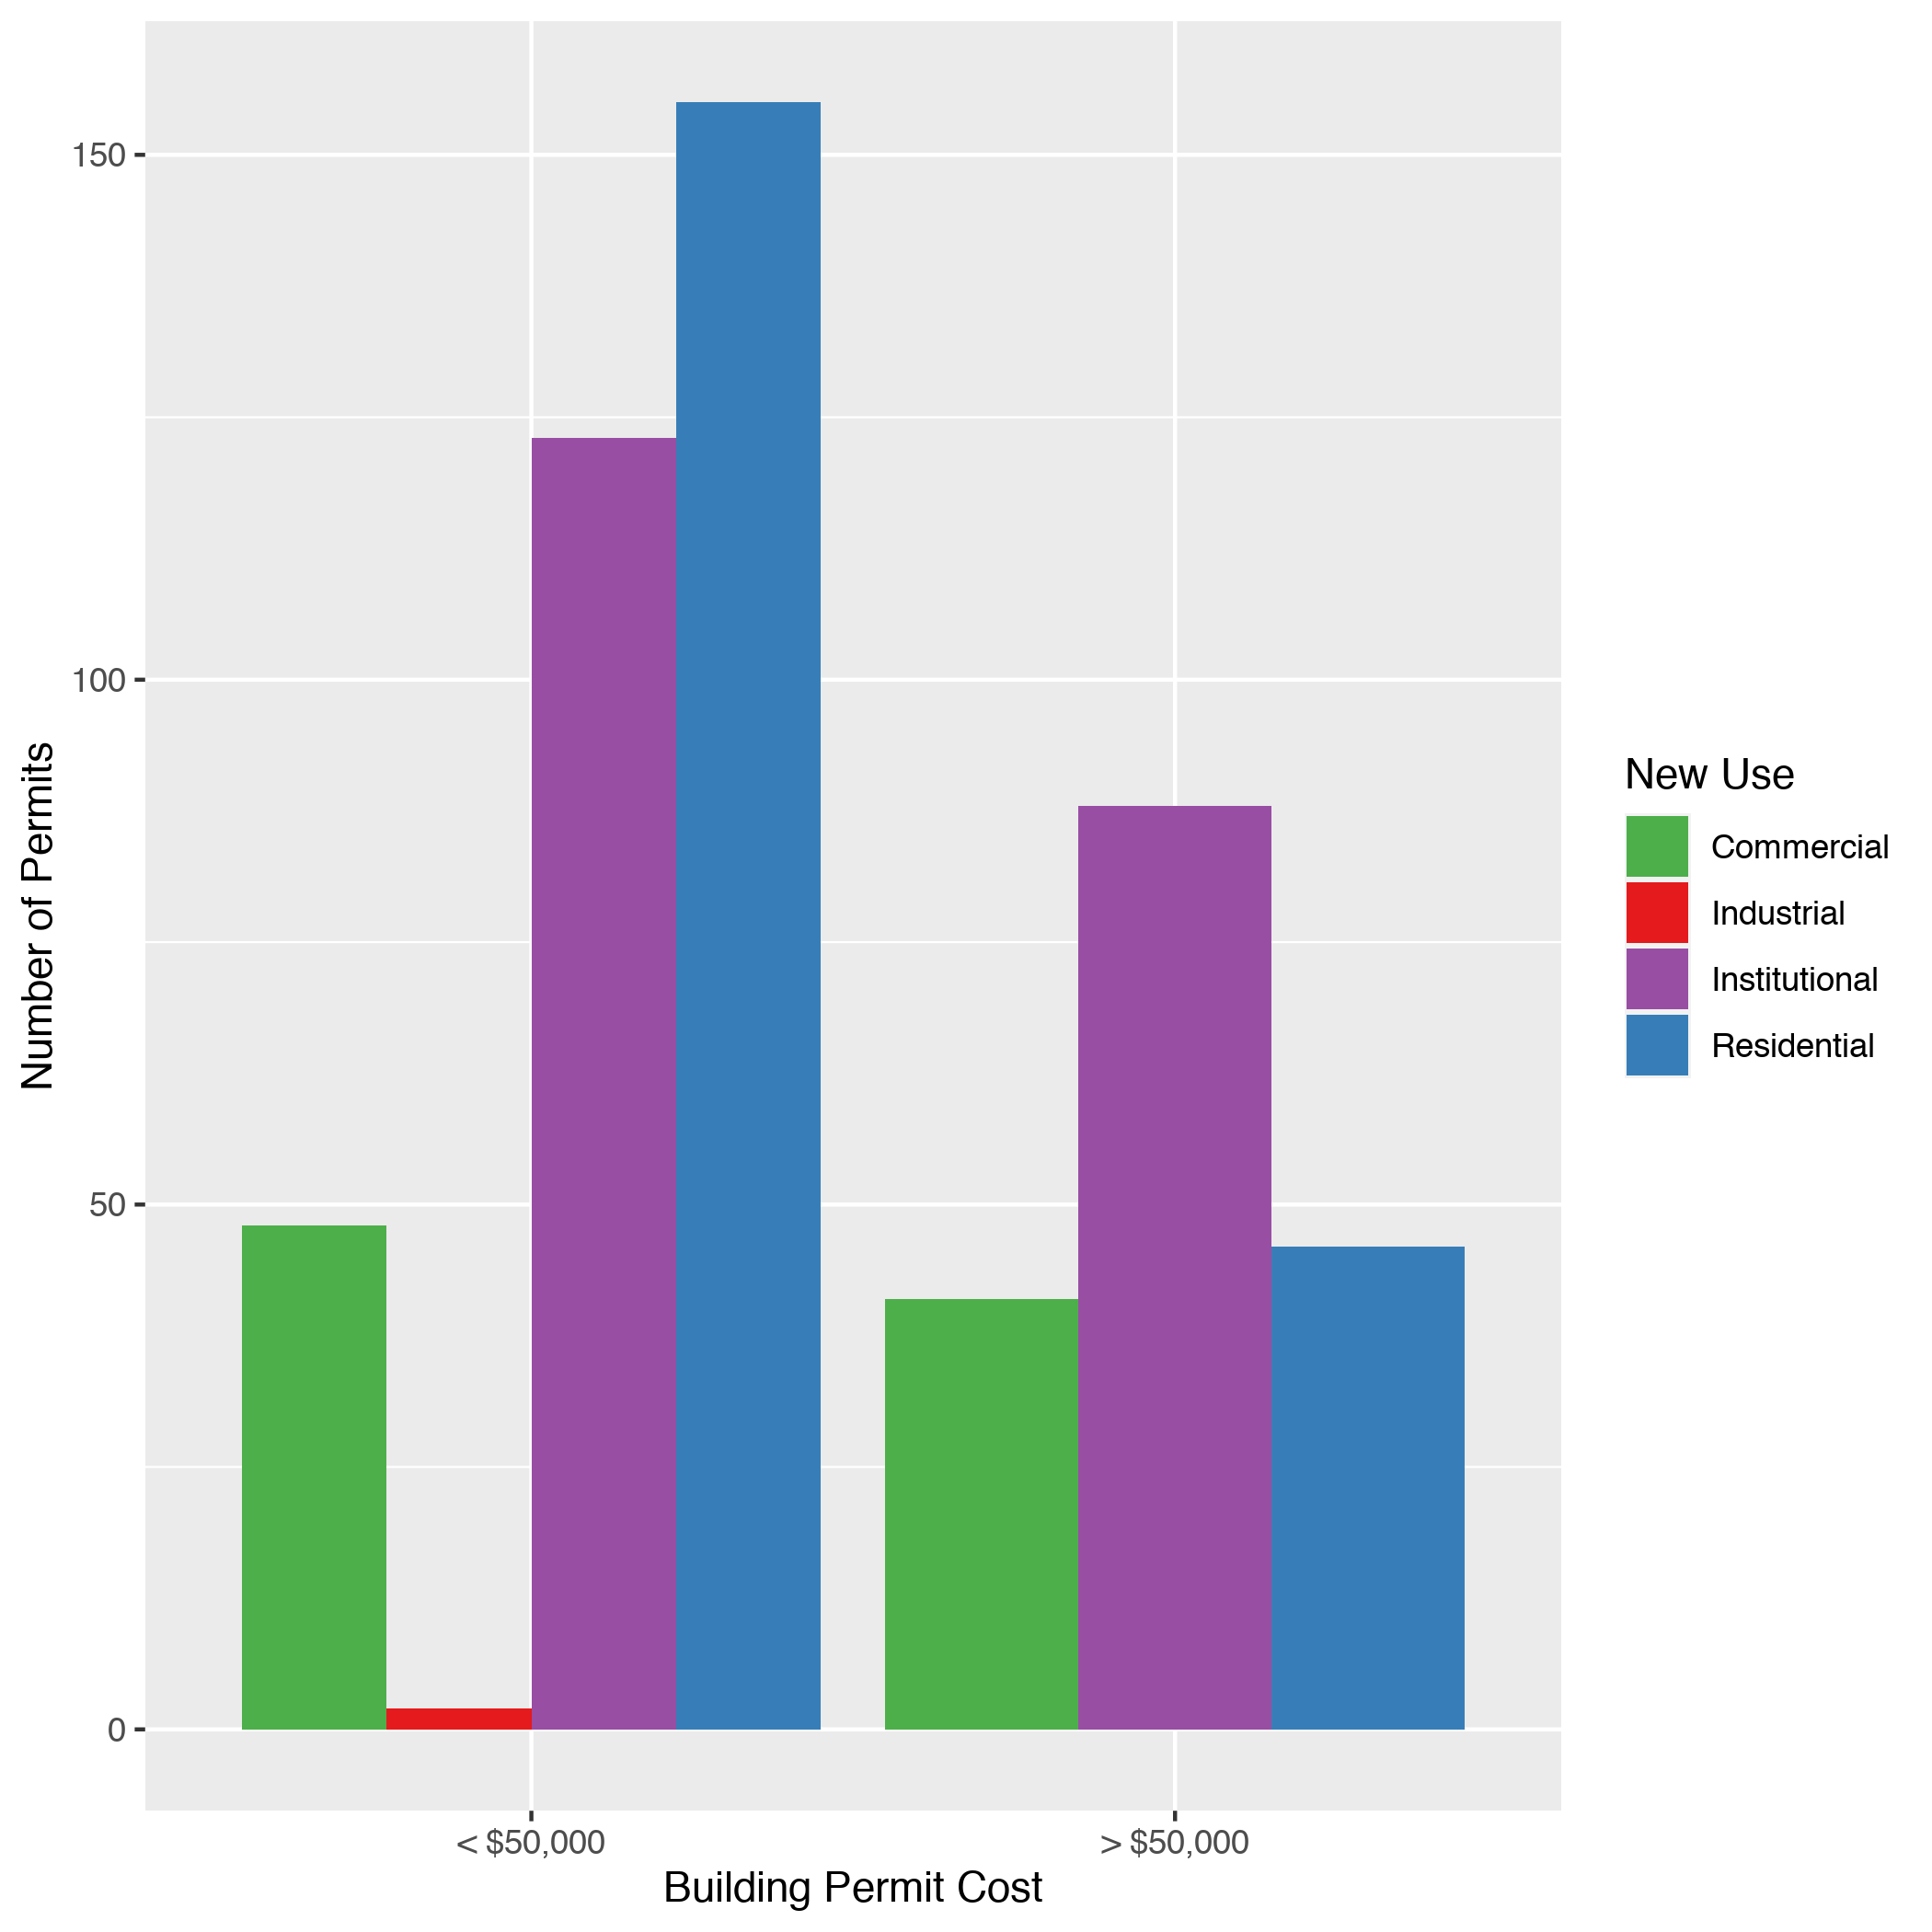
Central West End
New Use | Average Cost | # of Permits
Commercial | $492,849 | 89
Industrial | $5,000 | 2
Institutional | $359,089 | 211
Residential | $40,095 | 201

Slide 13
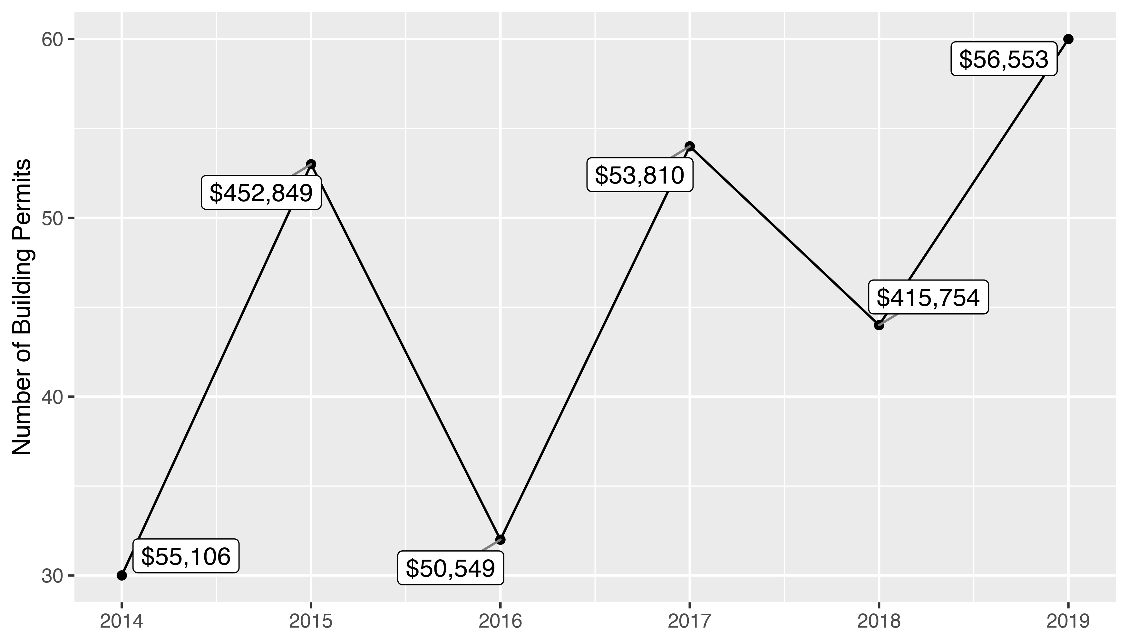
DeBaliviere Place 5 Year Analysis

Slide 14
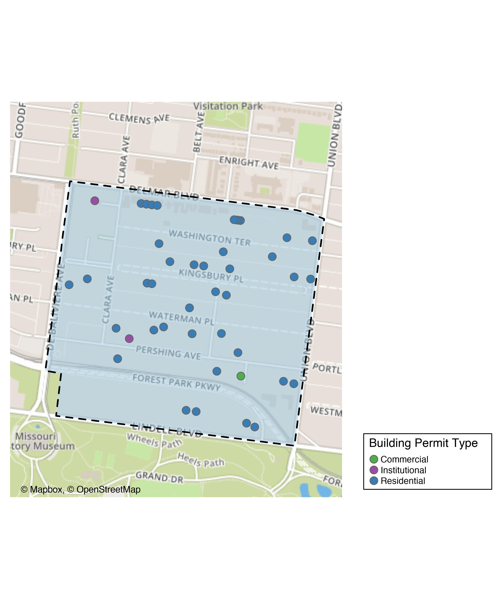
DeBaliviere Place

Slide 15
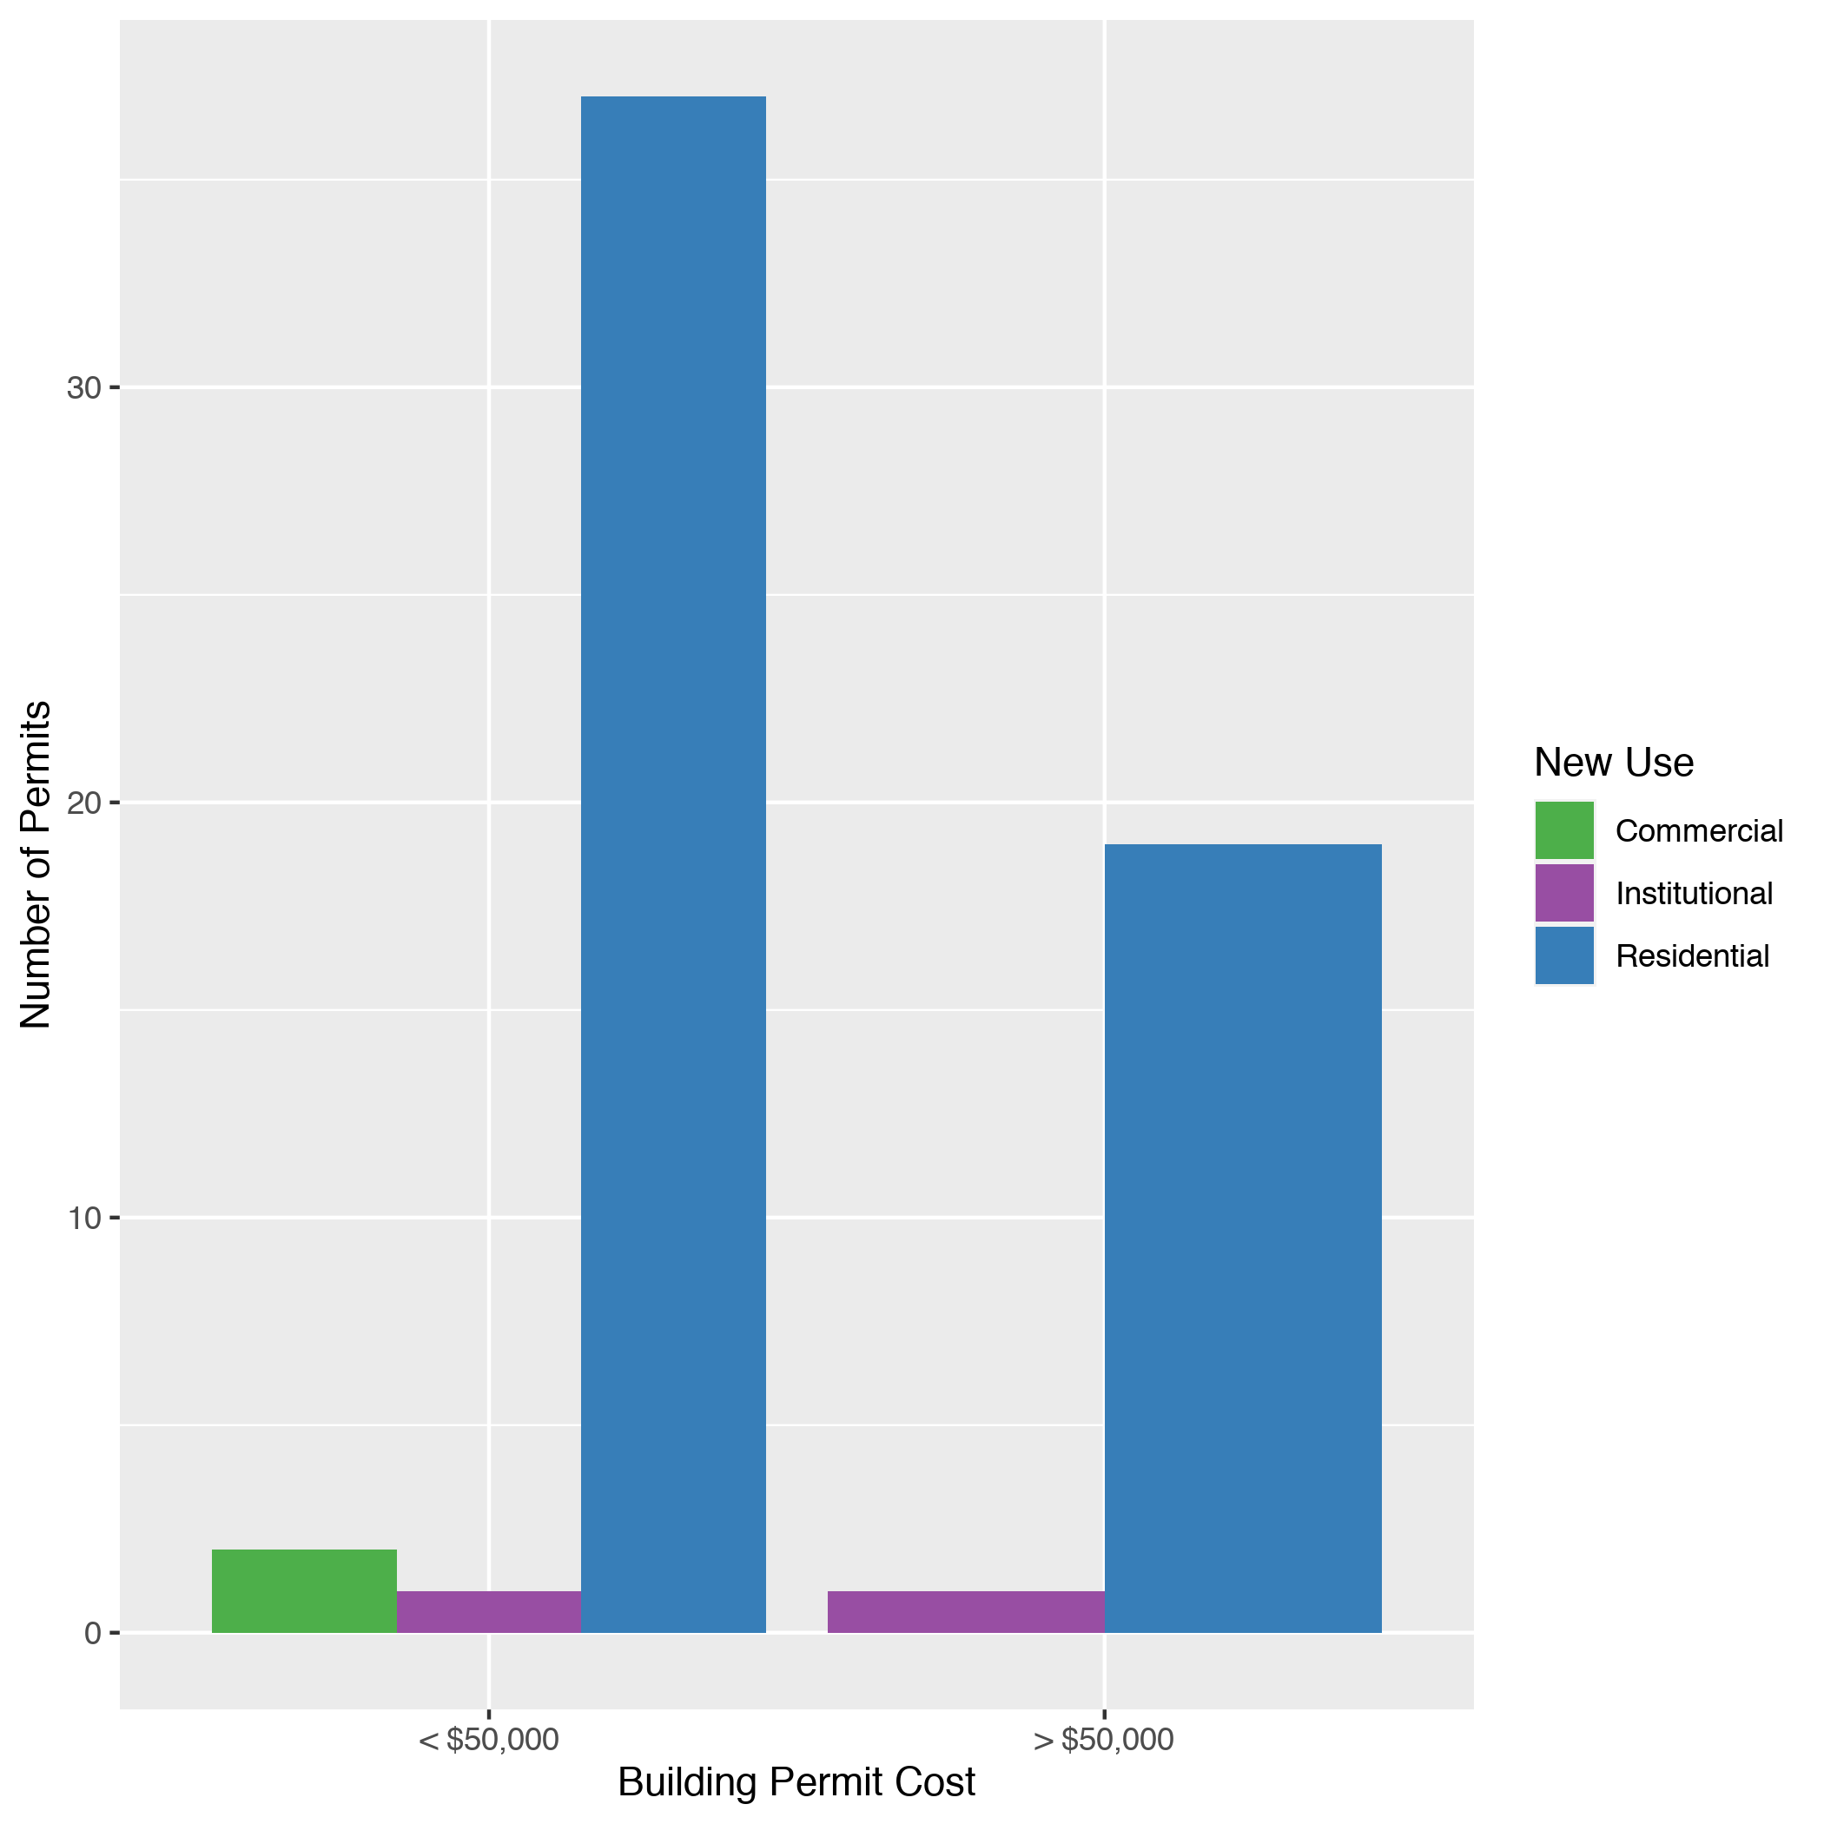
DeBaliviere Place
New Use | Average Cost | # of Permits
Commercial | $12,500 | 2
Institutional | $51,500 | 2
Residential | $58,307 | 56

Slide 16
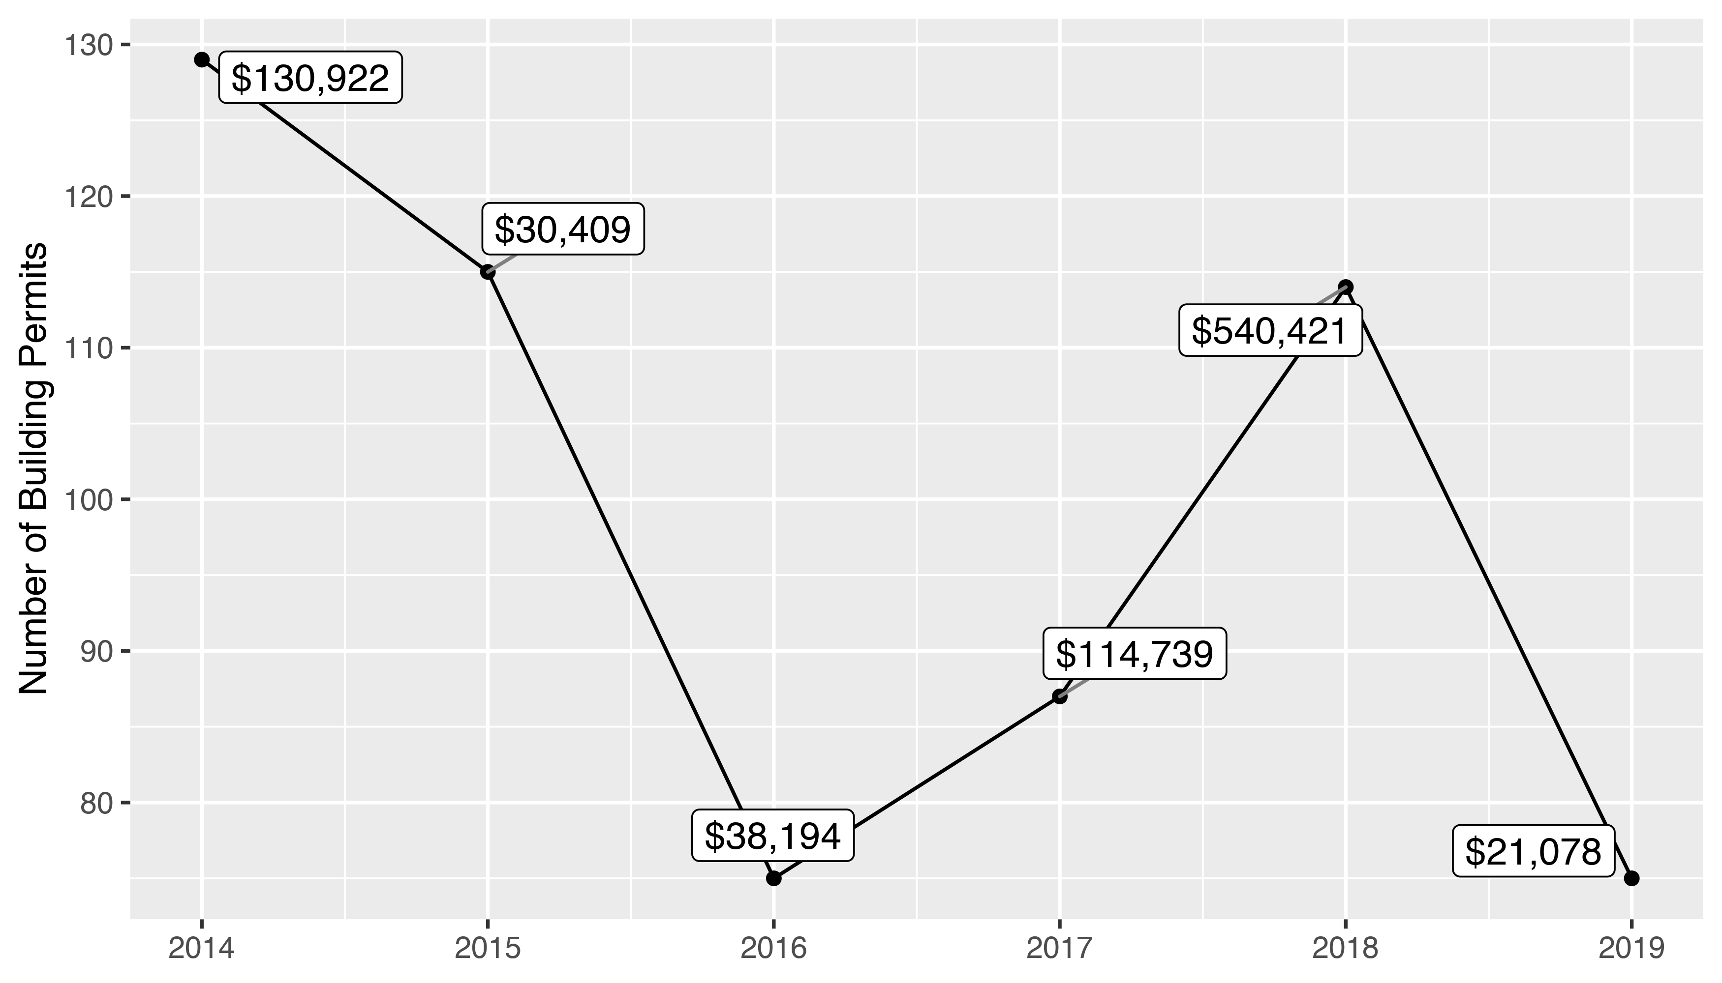
Skinker DeBaliviere 5 Year Analysis

Slide 17
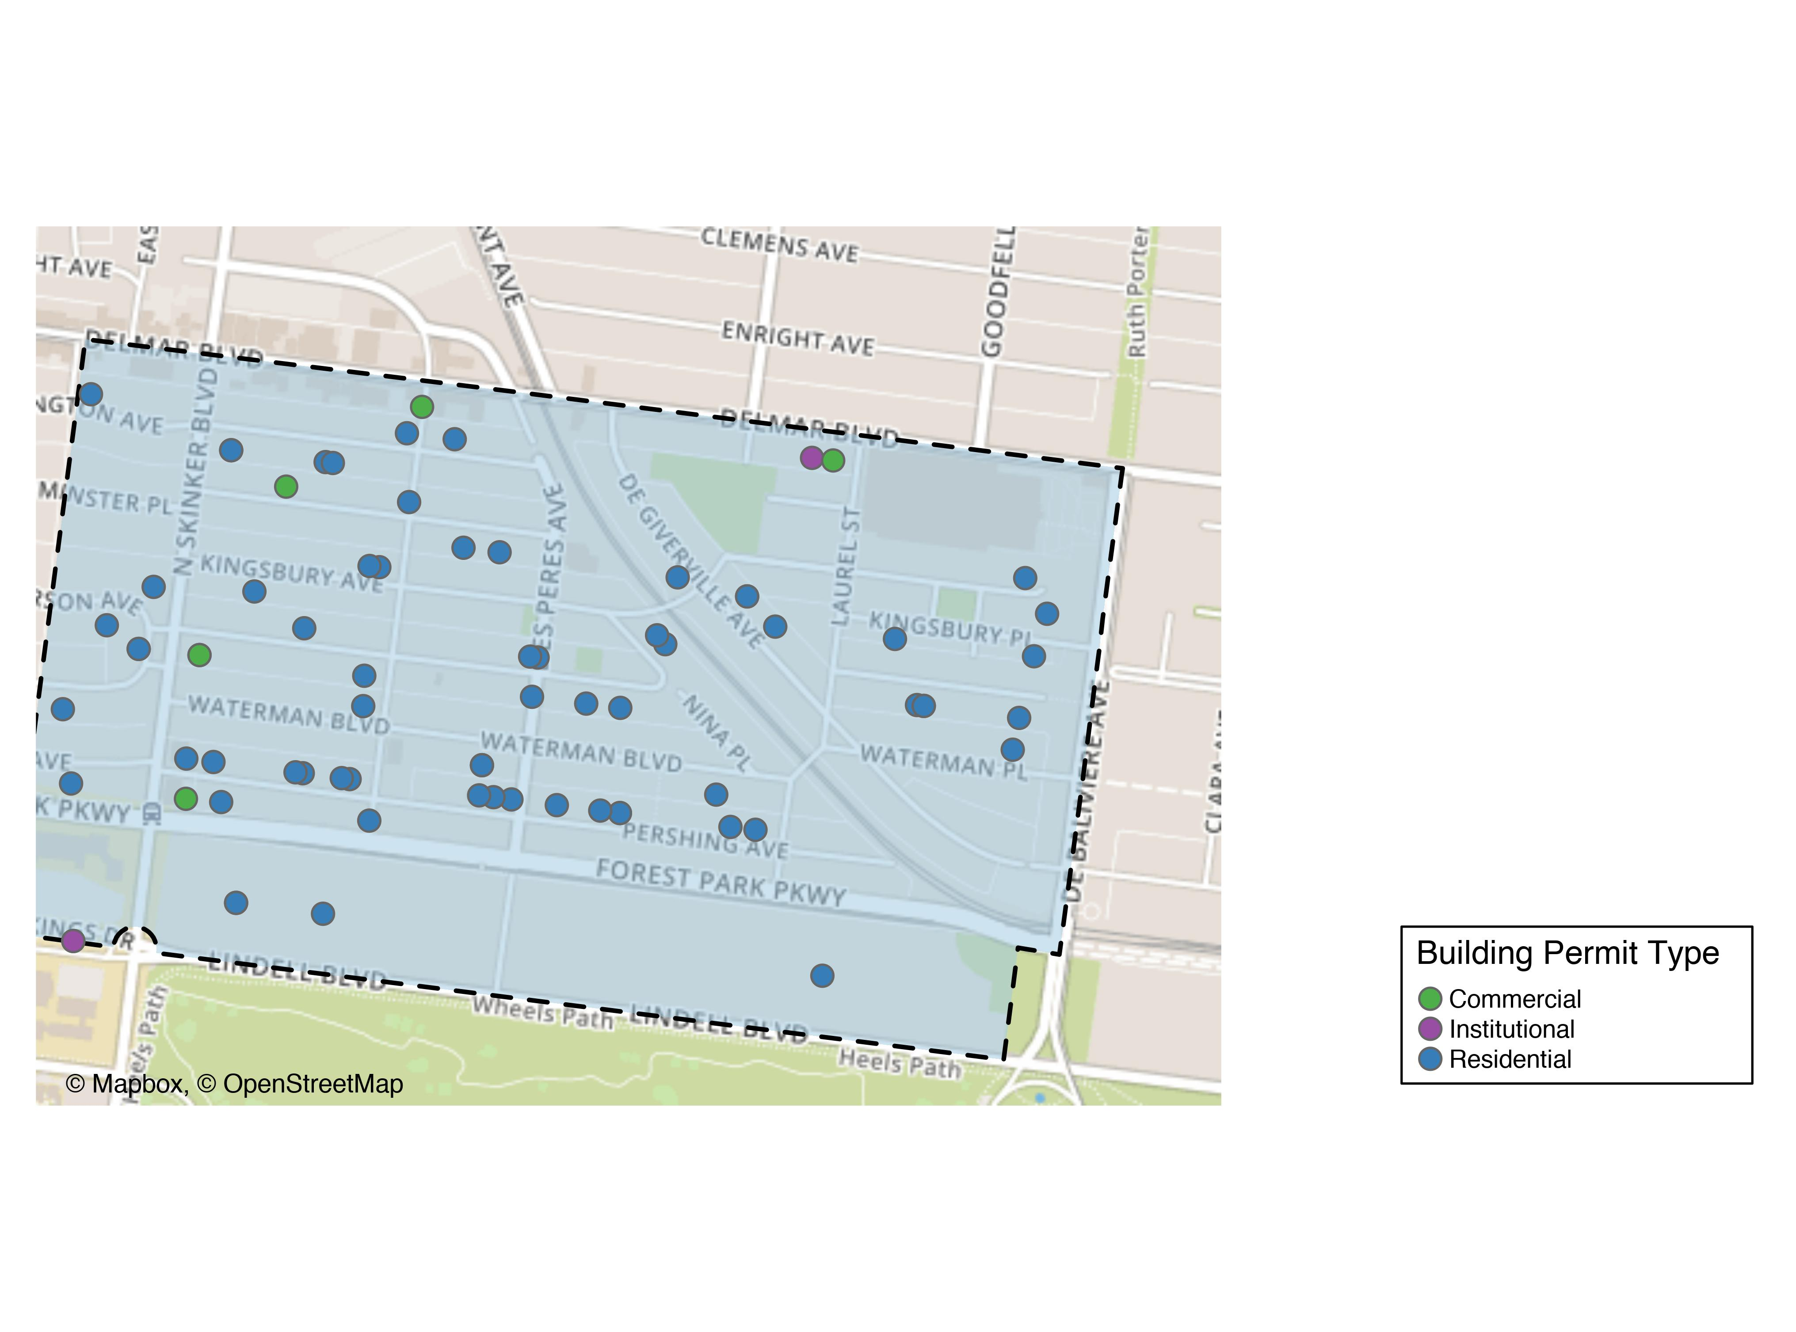
Skinker DeBaliviere

Slide 18
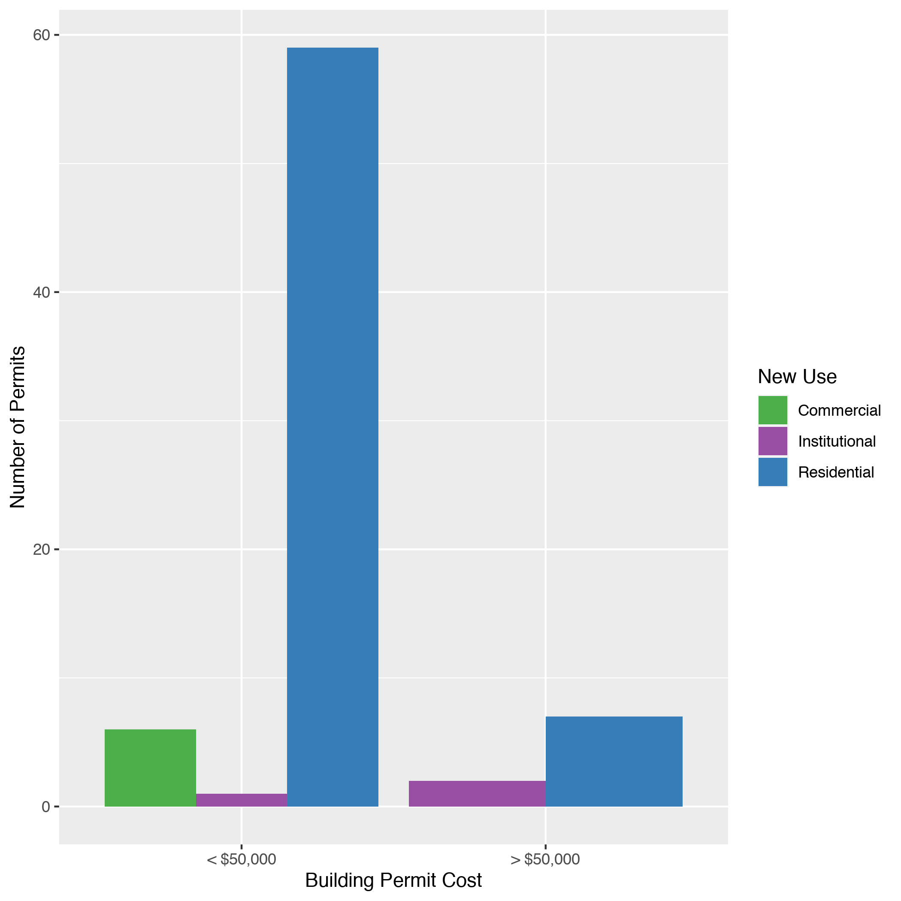
Skinker DeBaliviere
New Use | Average Cost | # of Permits
Commercial | $13,938 | 6
Institutional | $75,700 | 3
Residential | $19,244 | 66

Slide 19
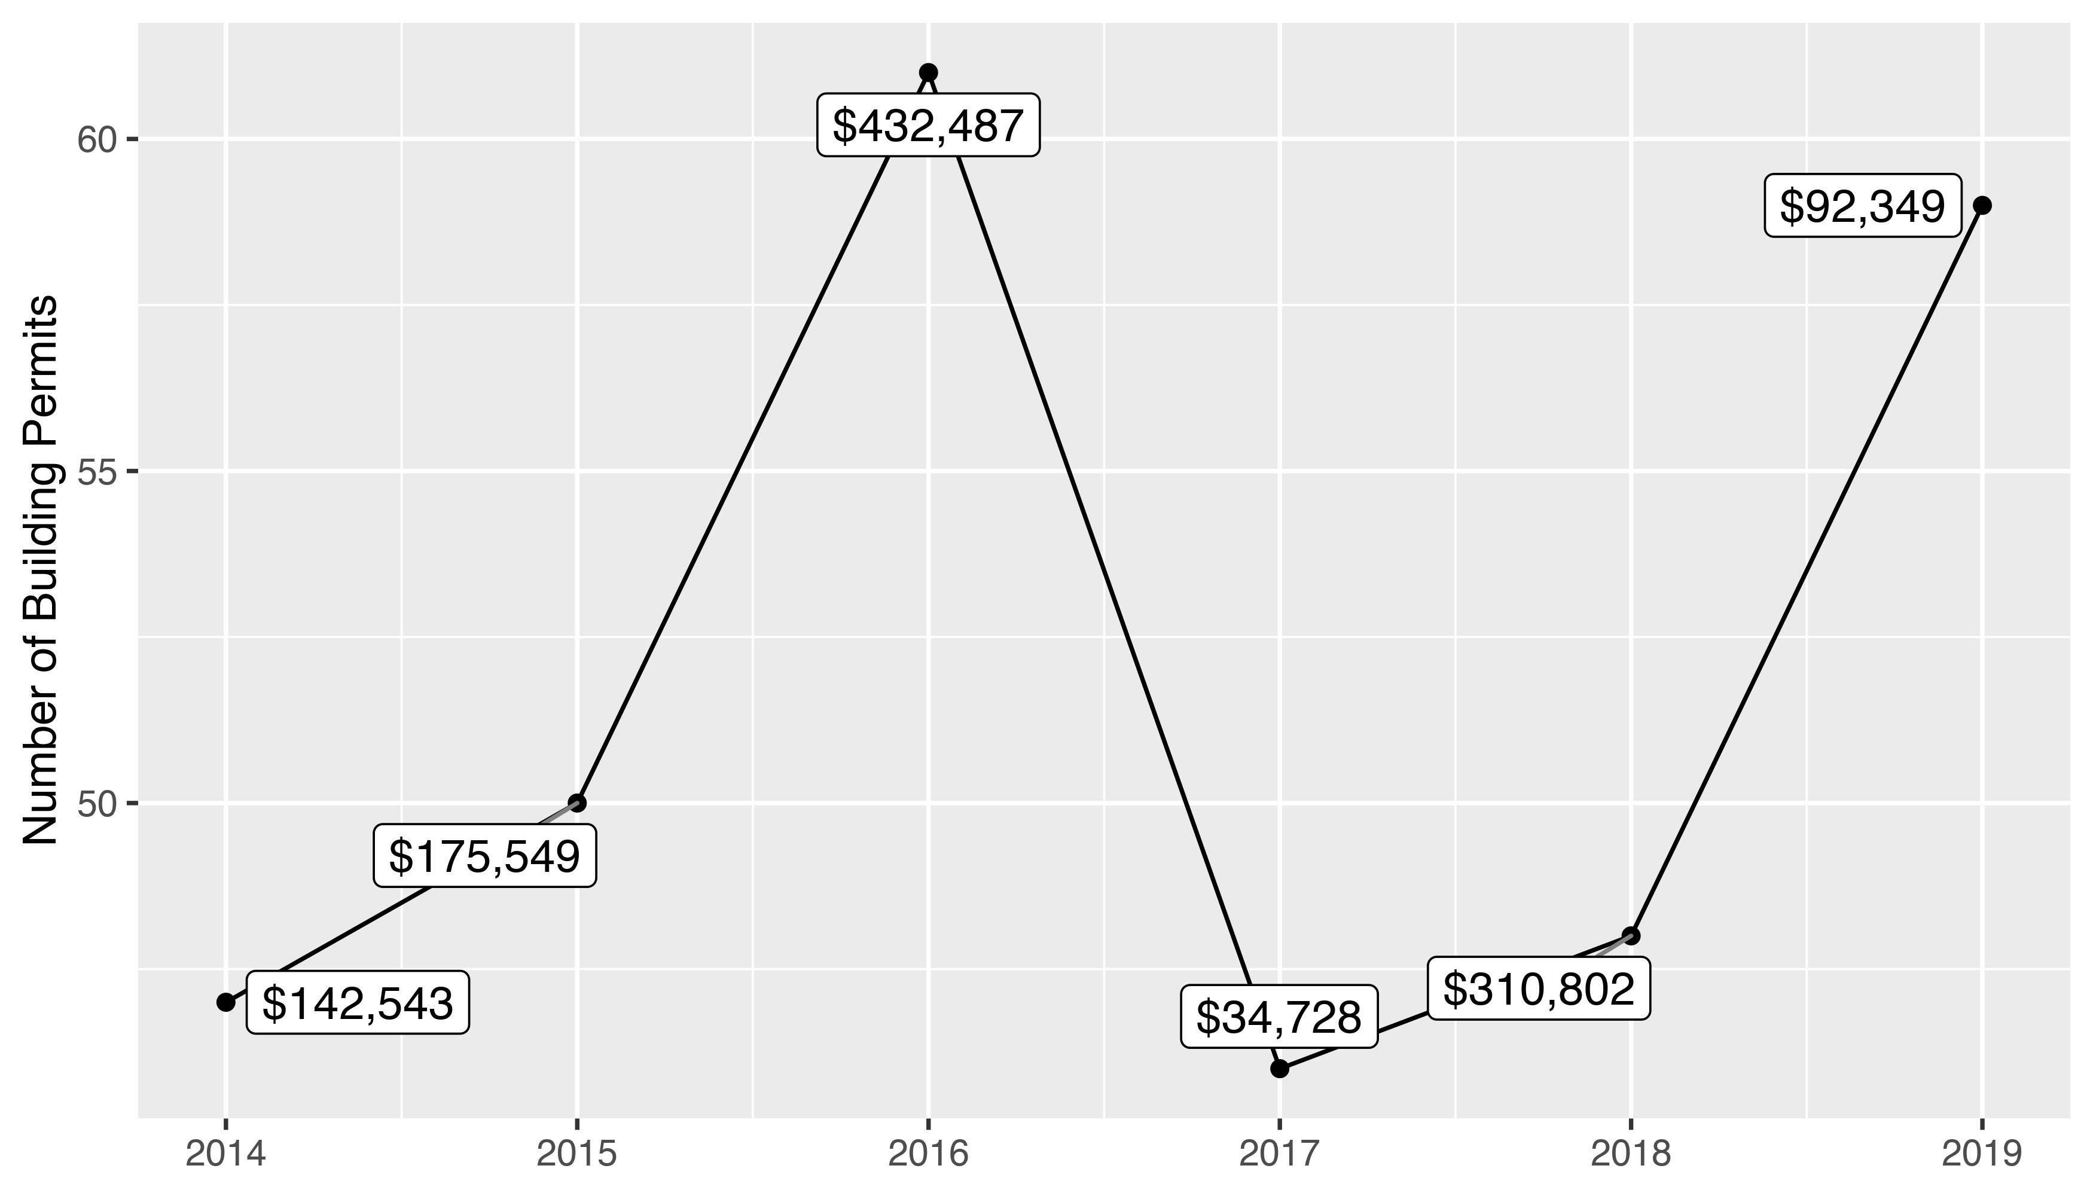
West End 5 Year Analysis

Slide 20
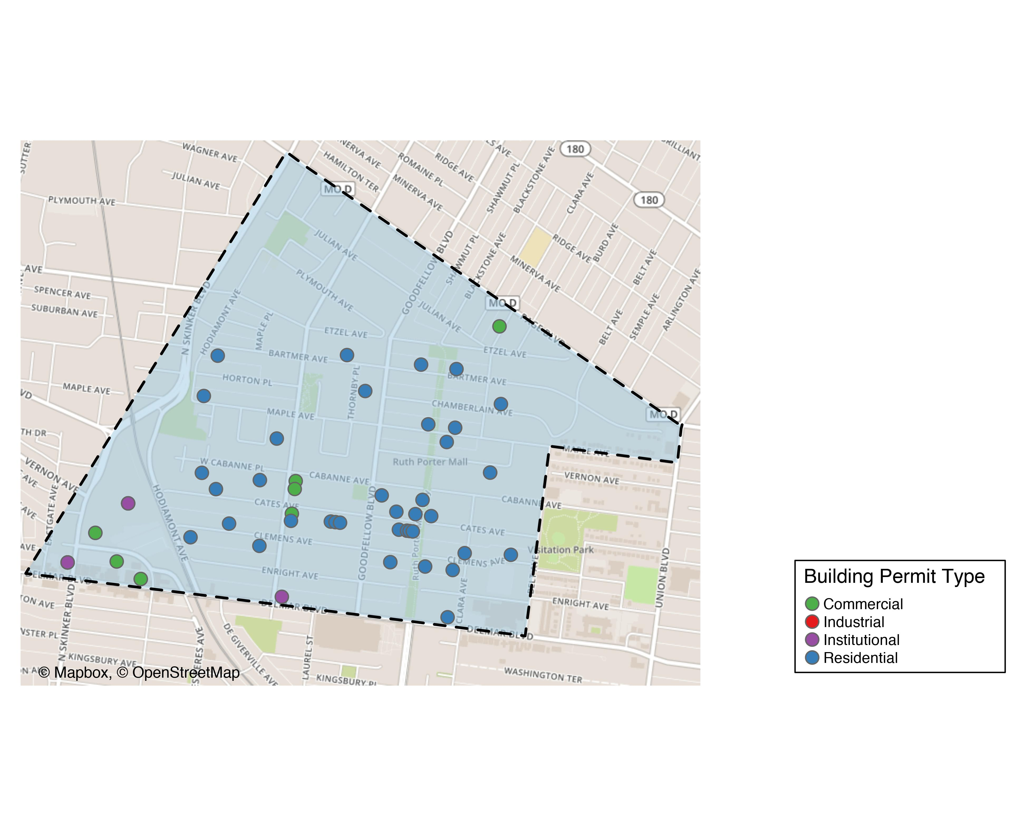
West End

Slide 21
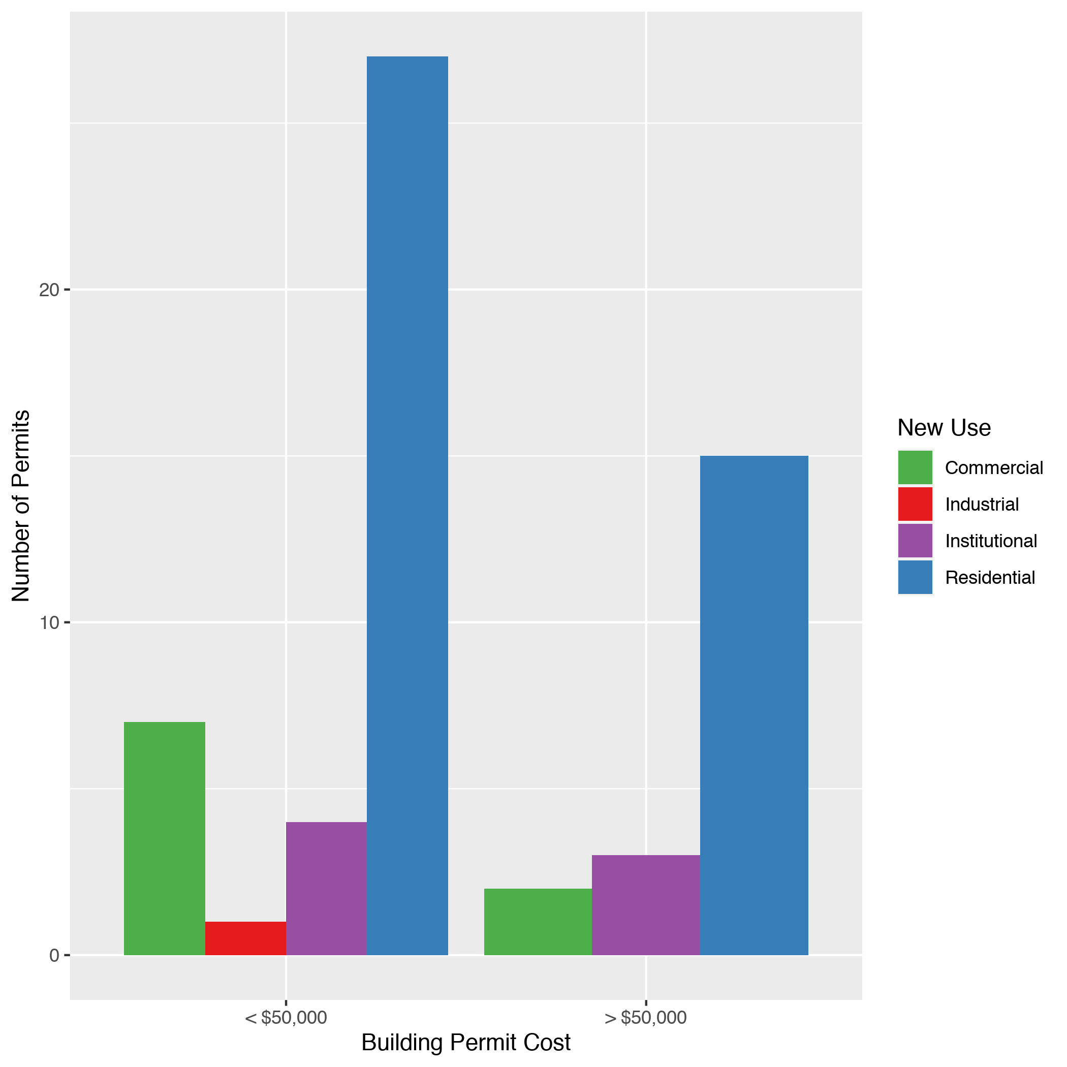
West End
New Use | Average Cost | # of Permits
Commercial | $191,700 | 9
Industrial | $30,000 | 1
Institutional | $158,080 | 7
Residential | $61,589 | 42

Slide 22
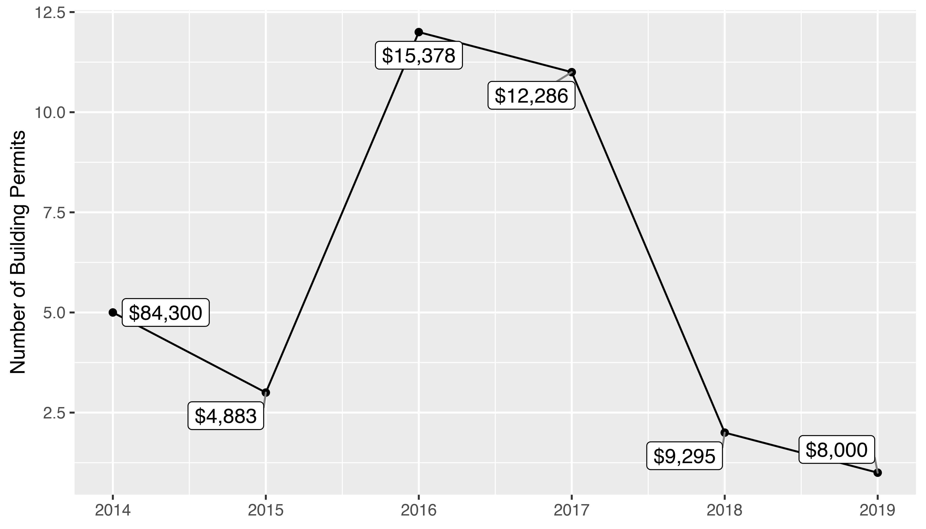
Visitation Park 5 Year Analysis

Slide 23
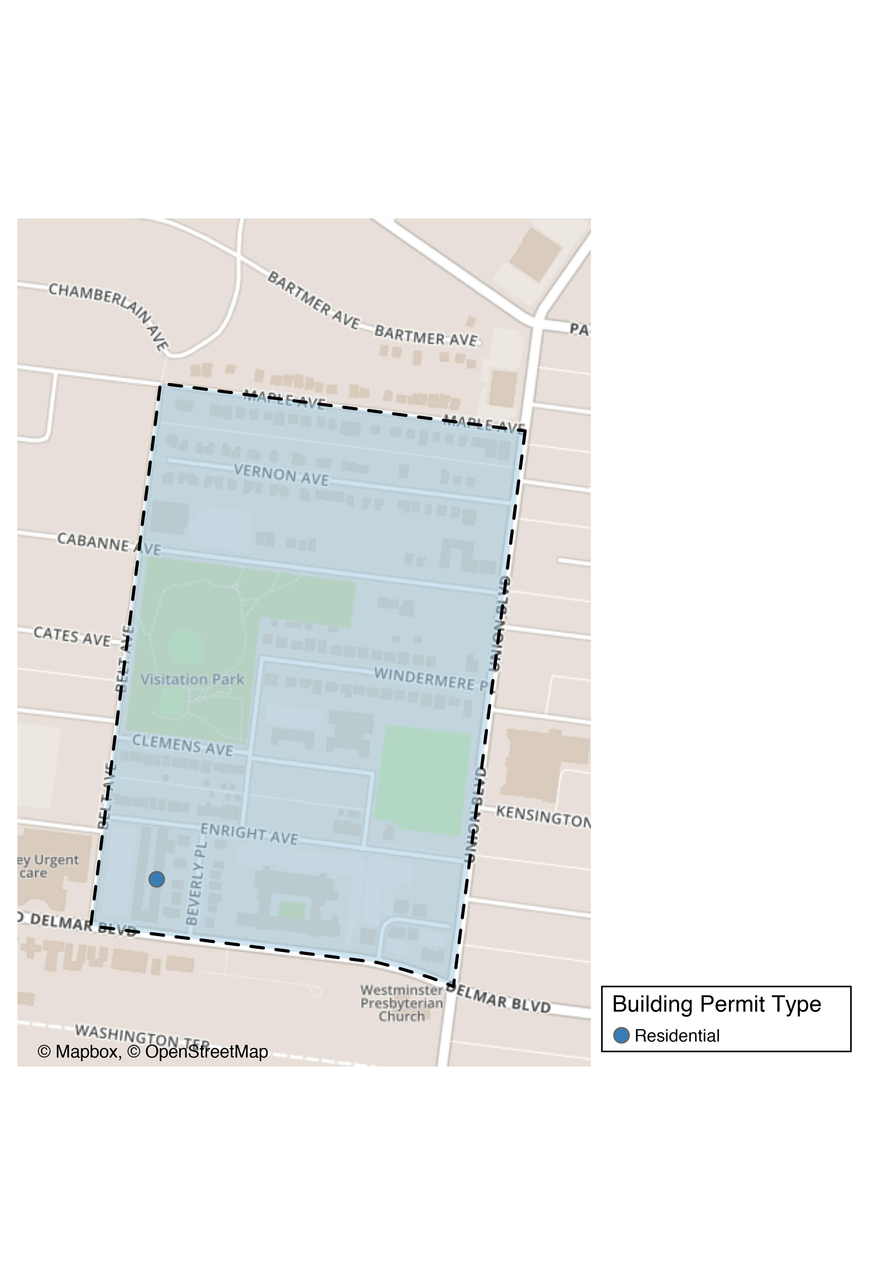
Visitation Park

Slide 24
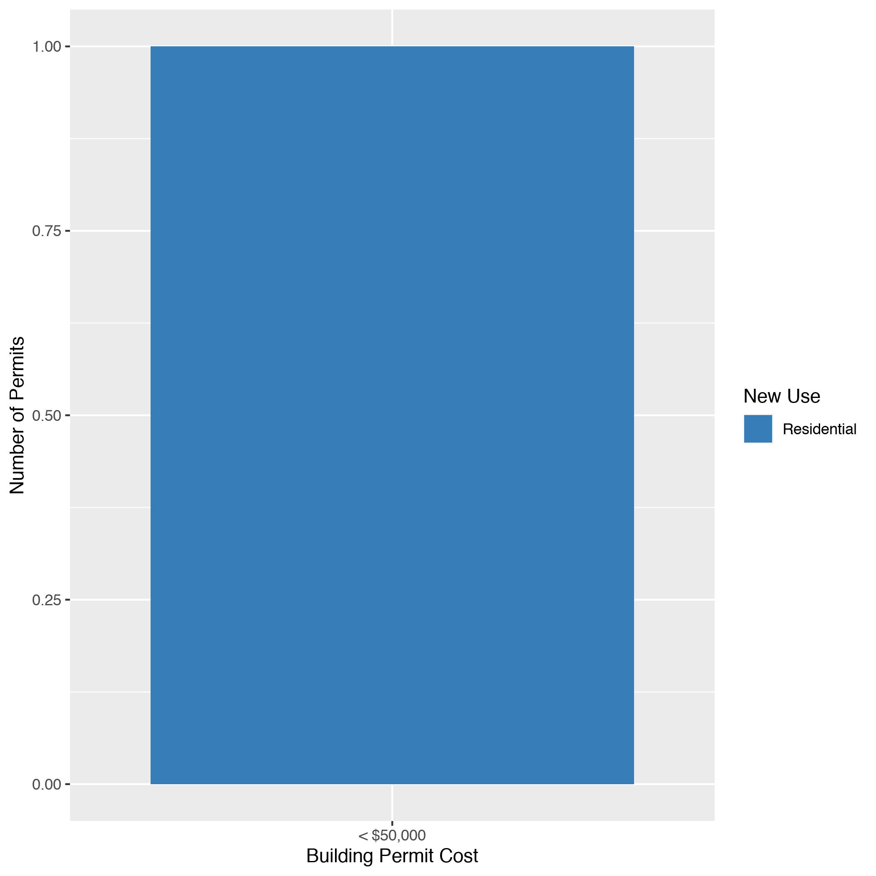
Visitation Park
New Use | Average Cost | # of Permits
Residential | $8,000 | 1

Slide 25
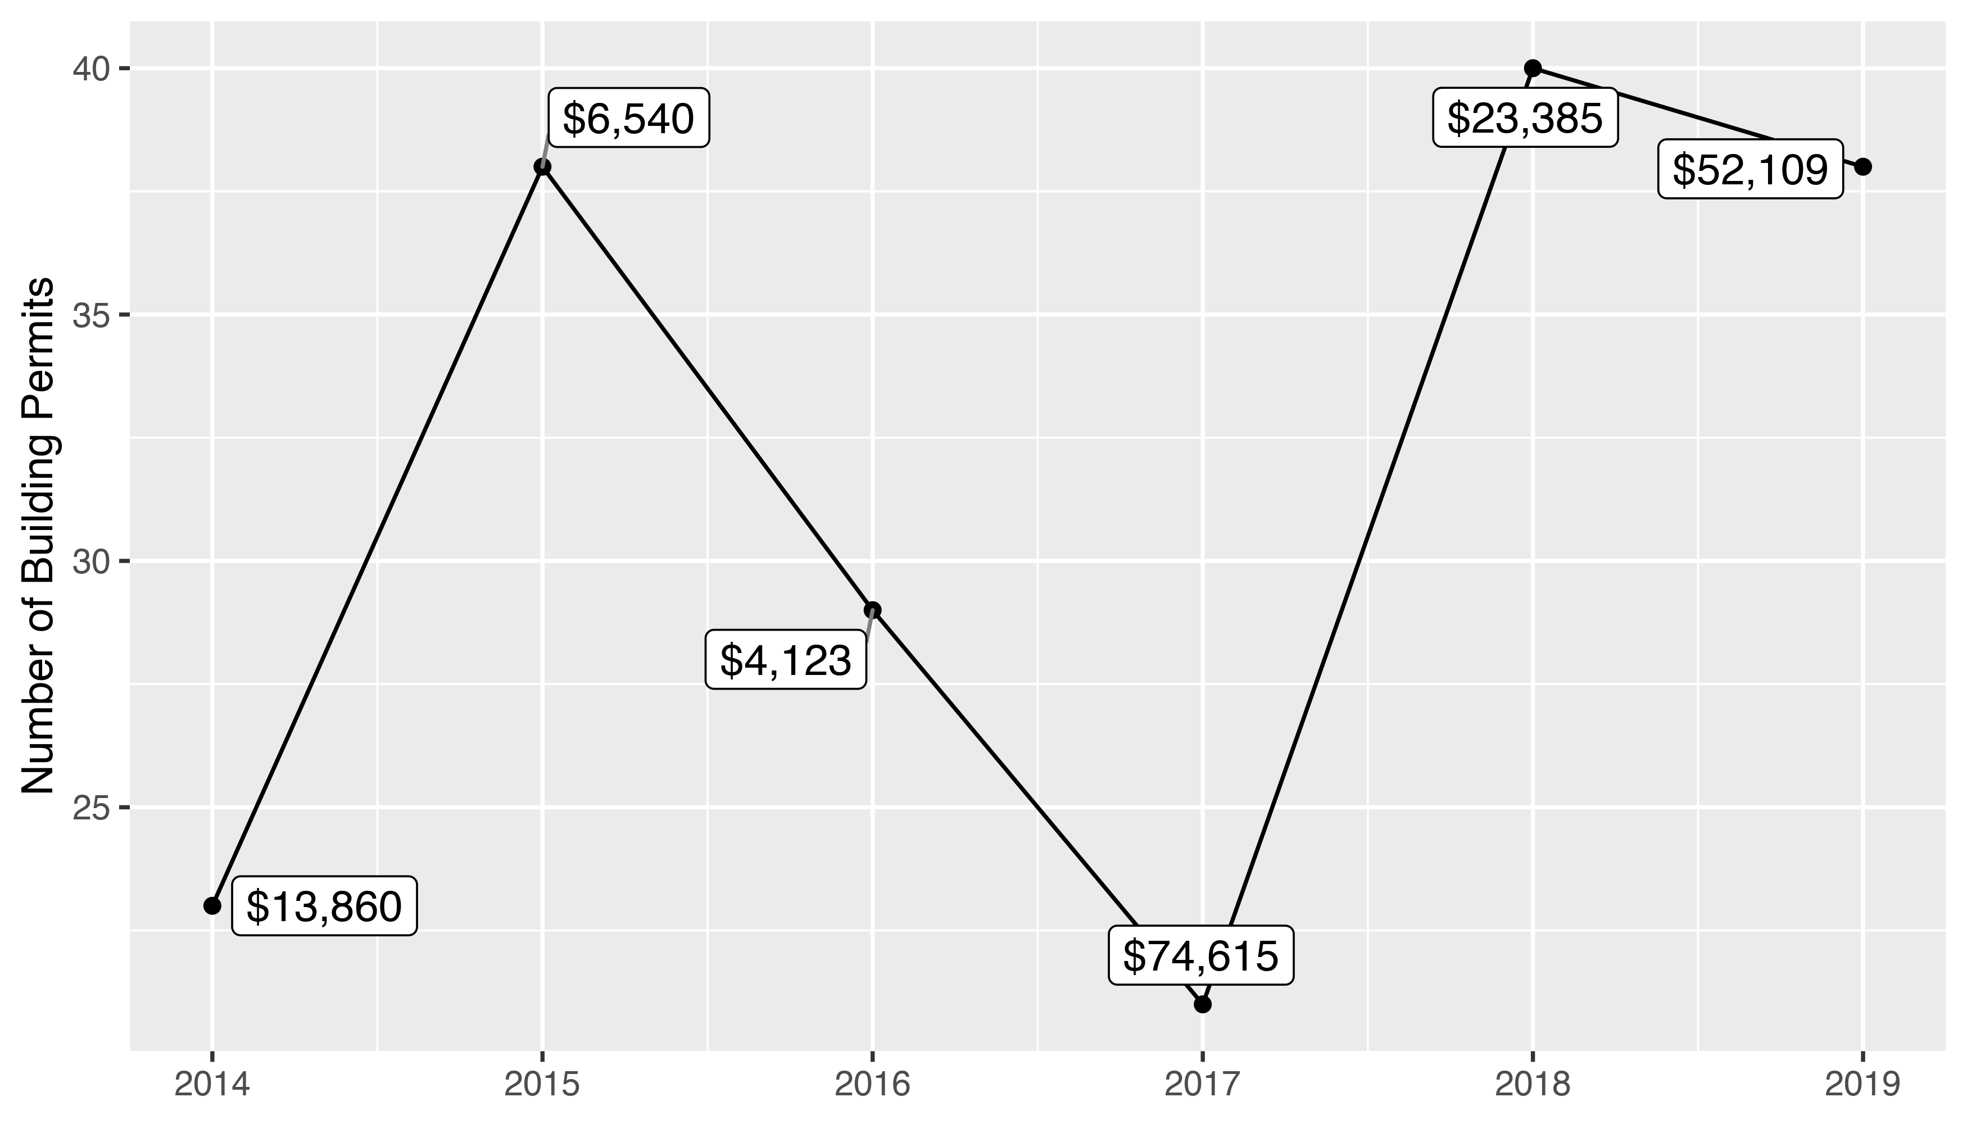
Academy 5 Year Analysis

Slide 26
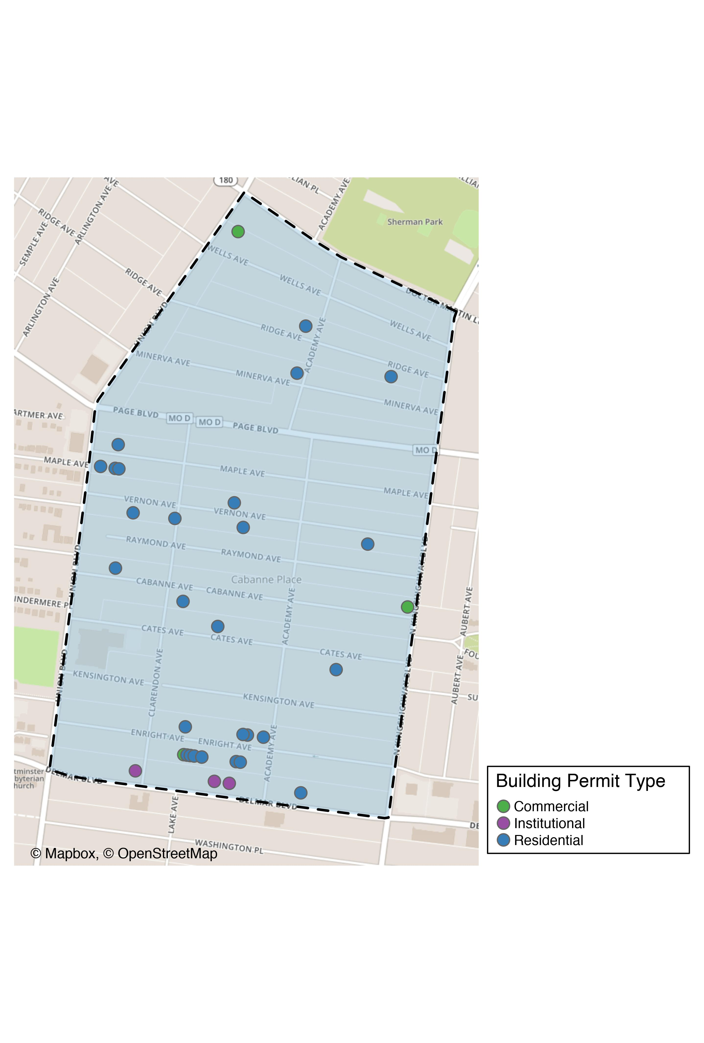
Academy

Slide 27
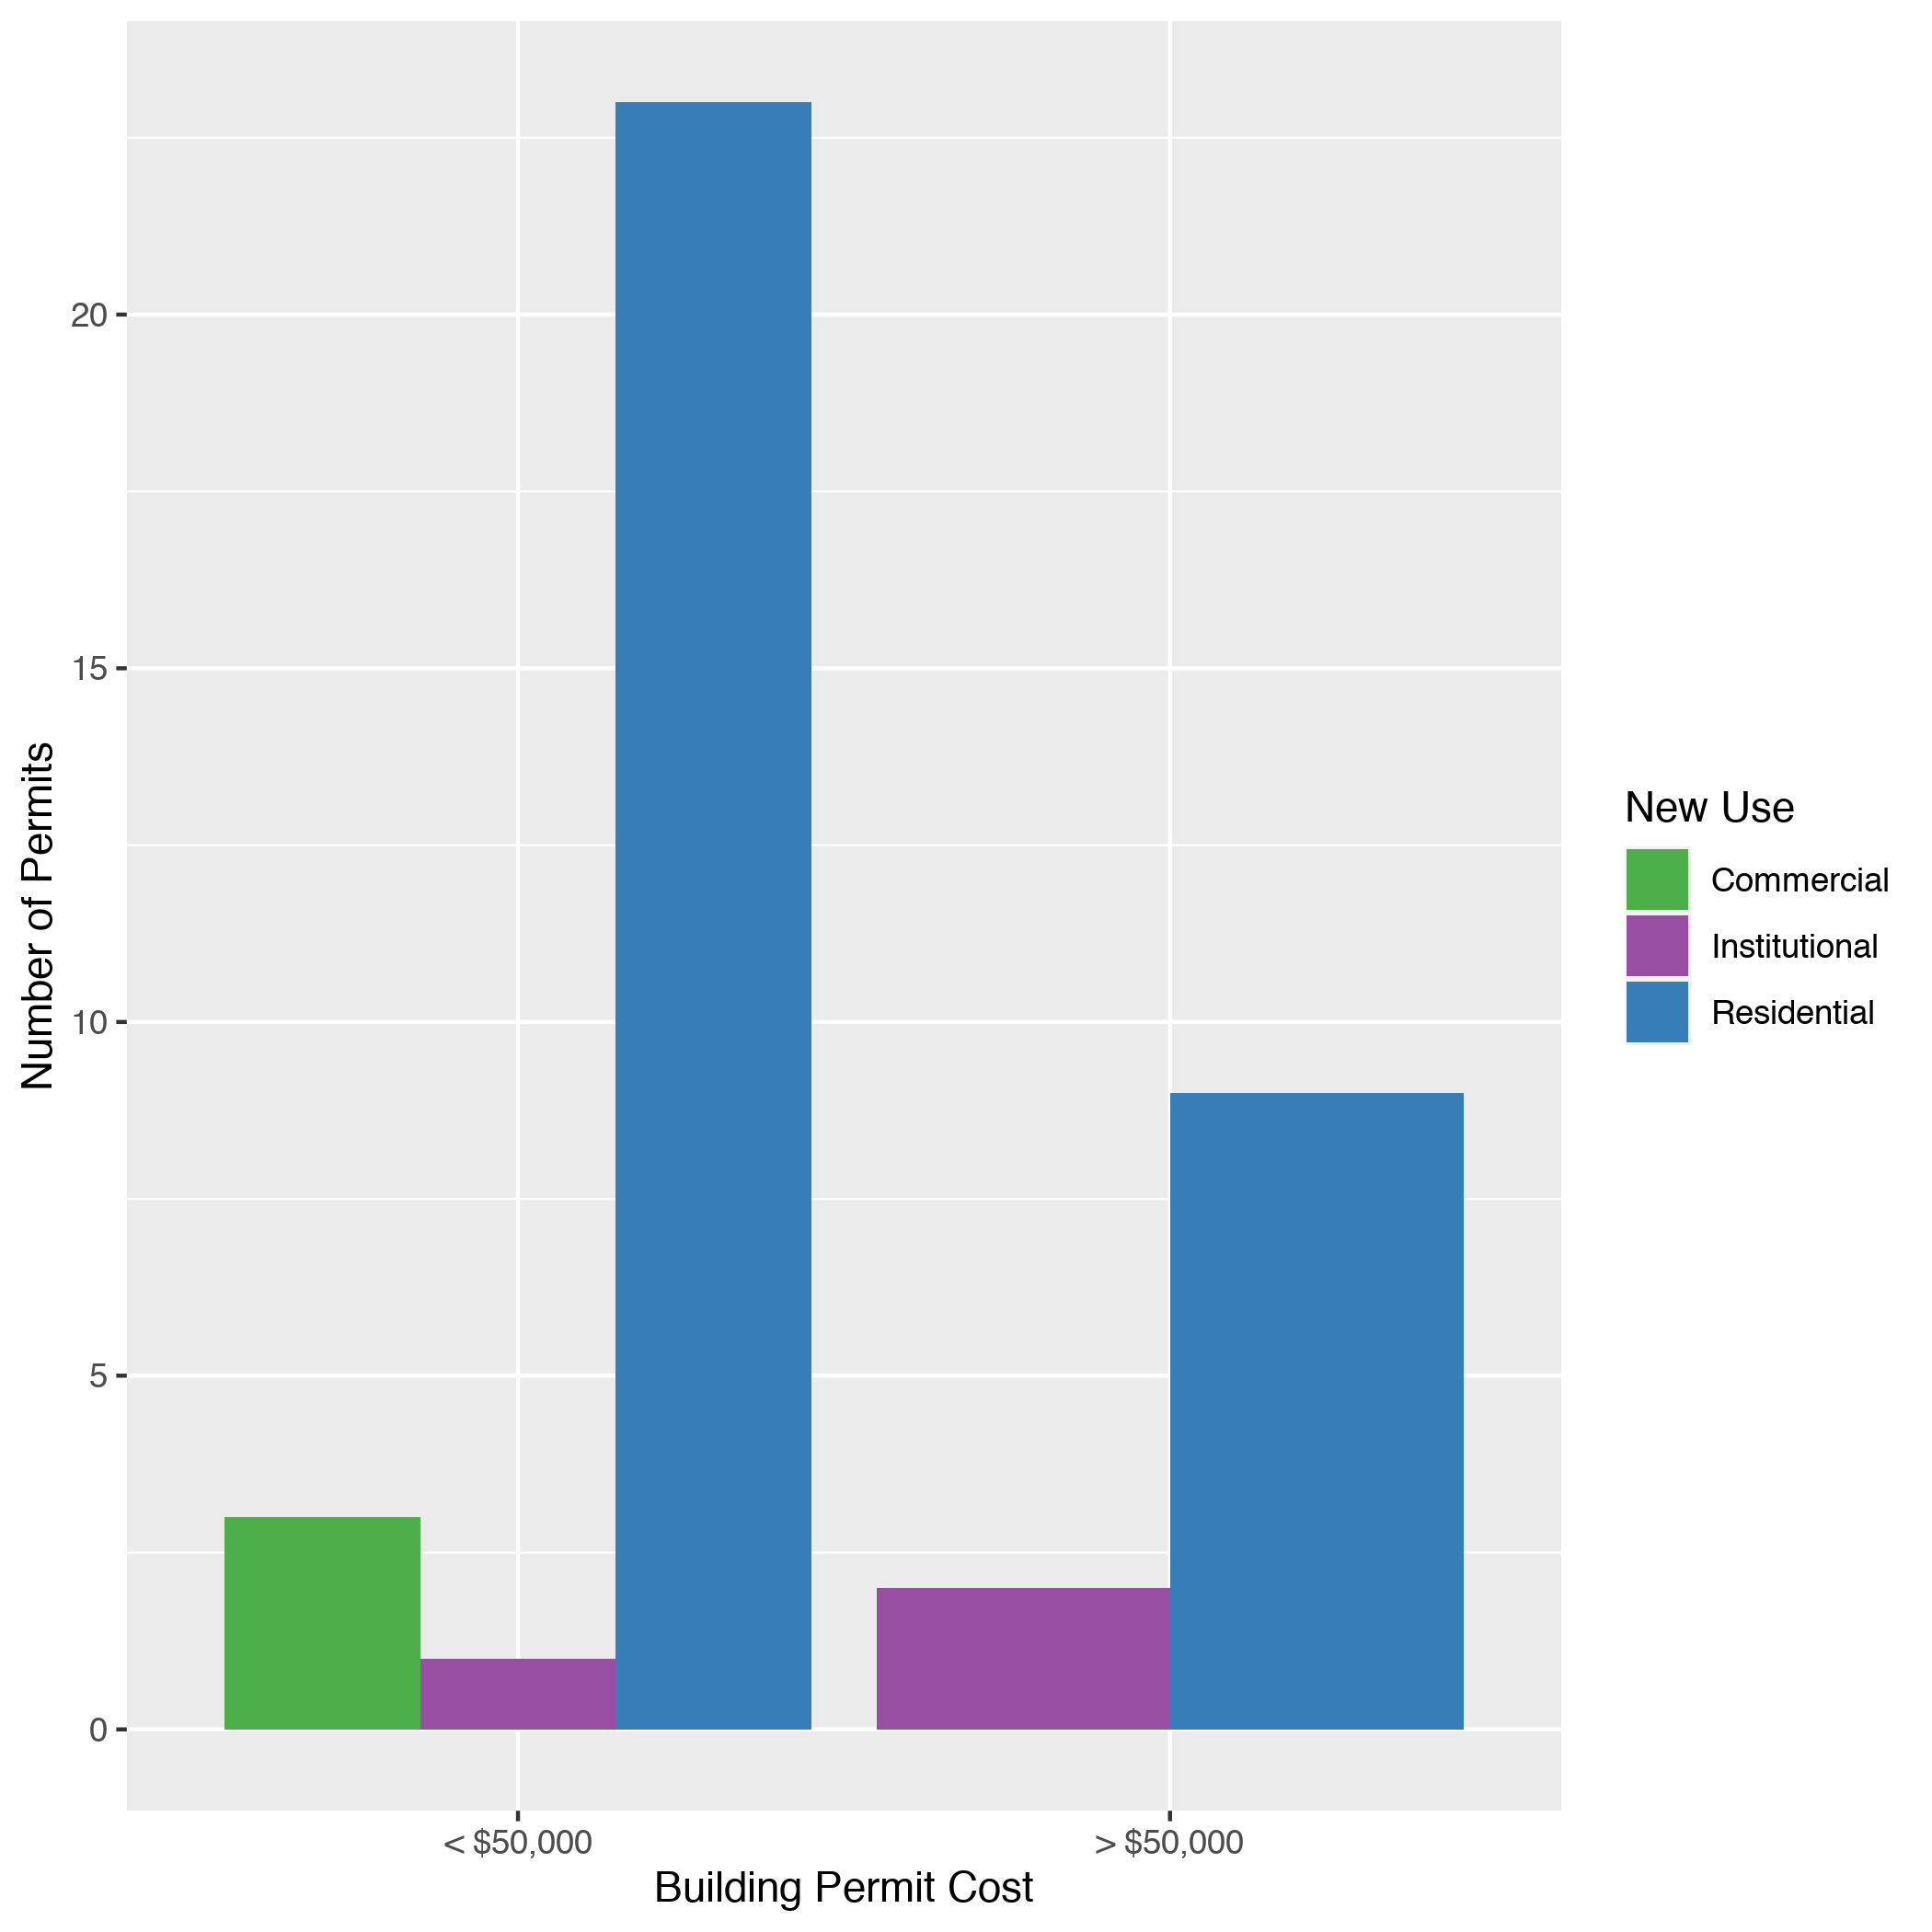
Academy
New Use | Average Cost | # of Permits
Commercial | $2,950 | 3
Institutional | $102,333 | 3
Residential | $52,010 | 32

Slide 28
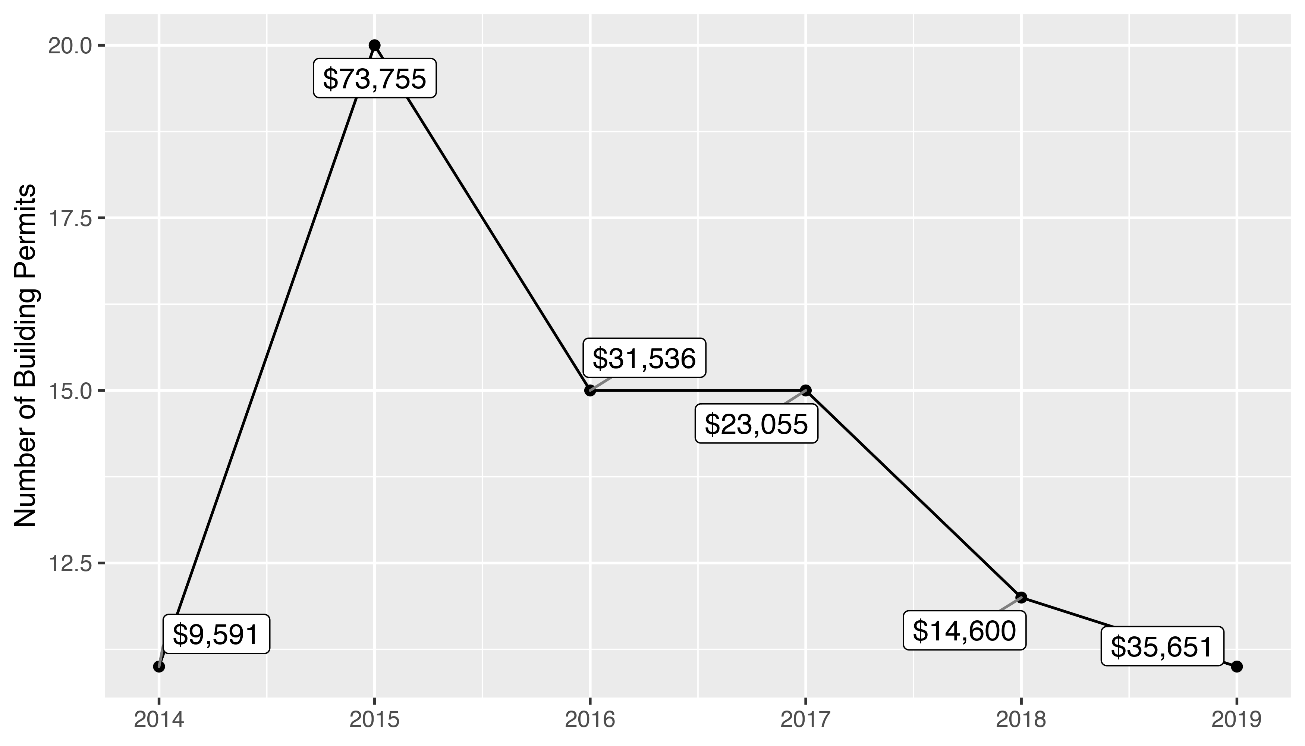
Fountain Park 5 Year Analysis

Slide 29
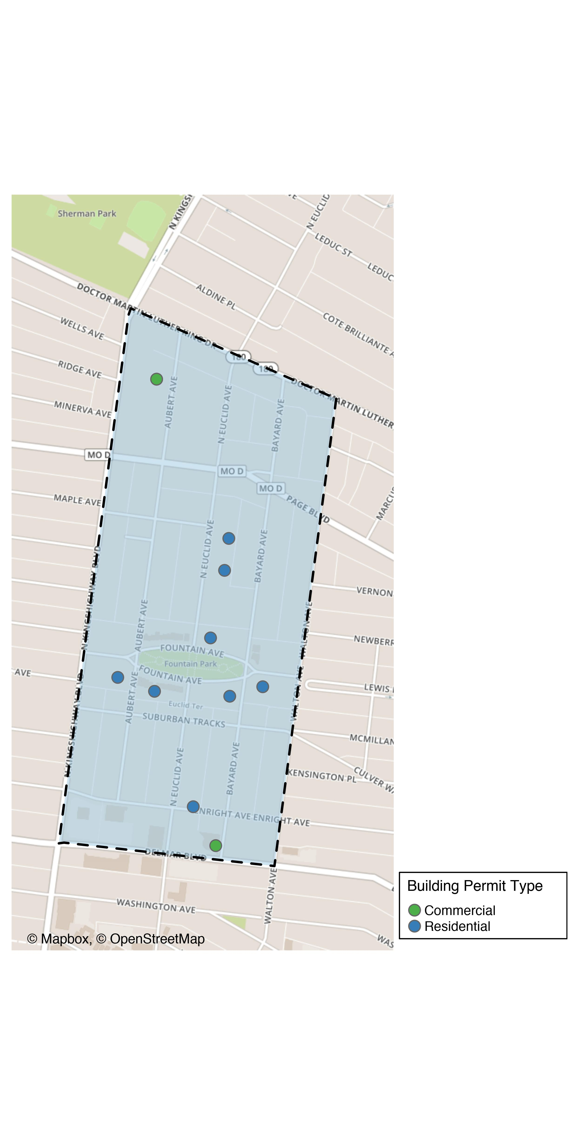
Fountain Park

Slide 30
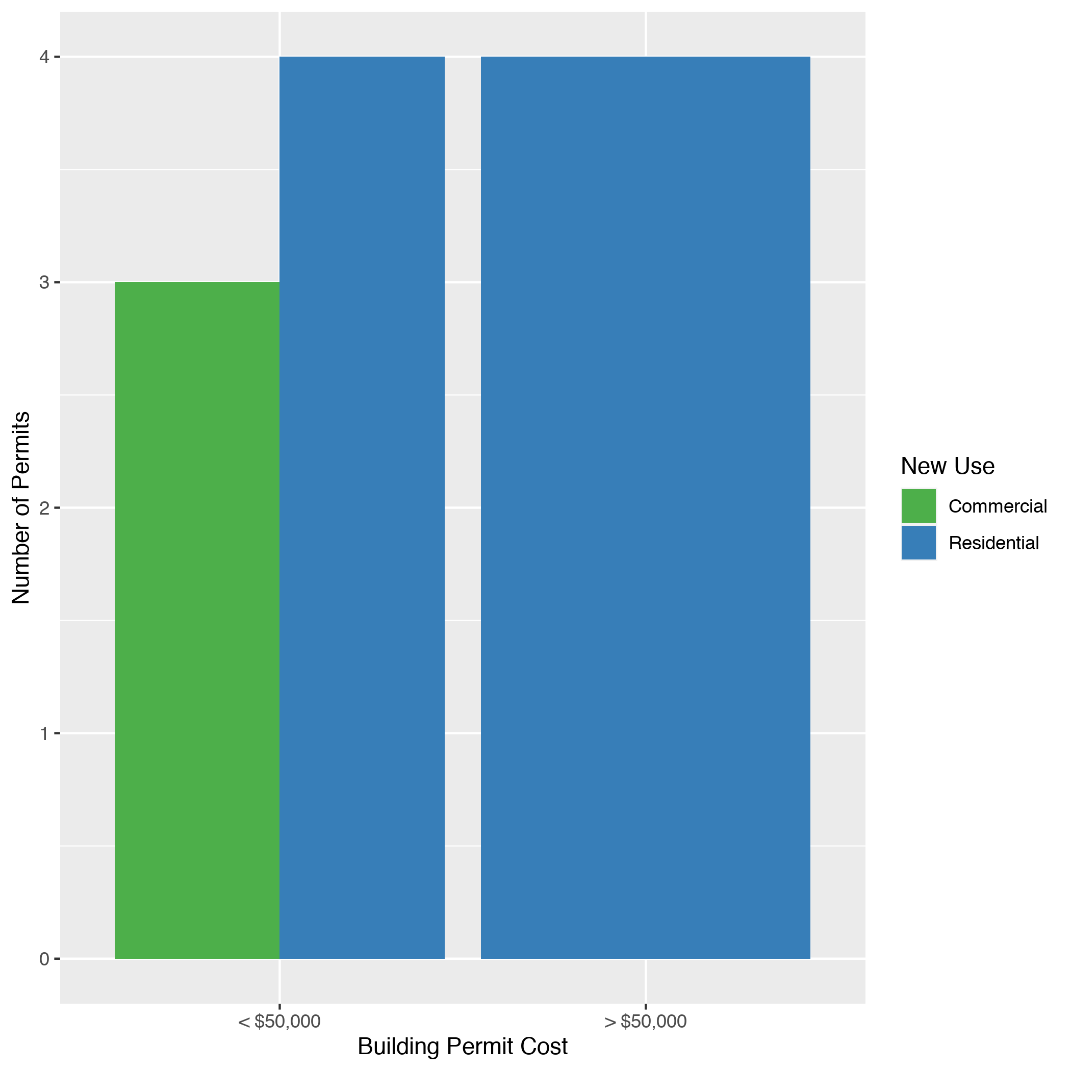
Fountain Park
New Use | Average Cost | # of Permits
Commercial | $18,722 | 3
Residential | $42,000 | 8

Slide 31
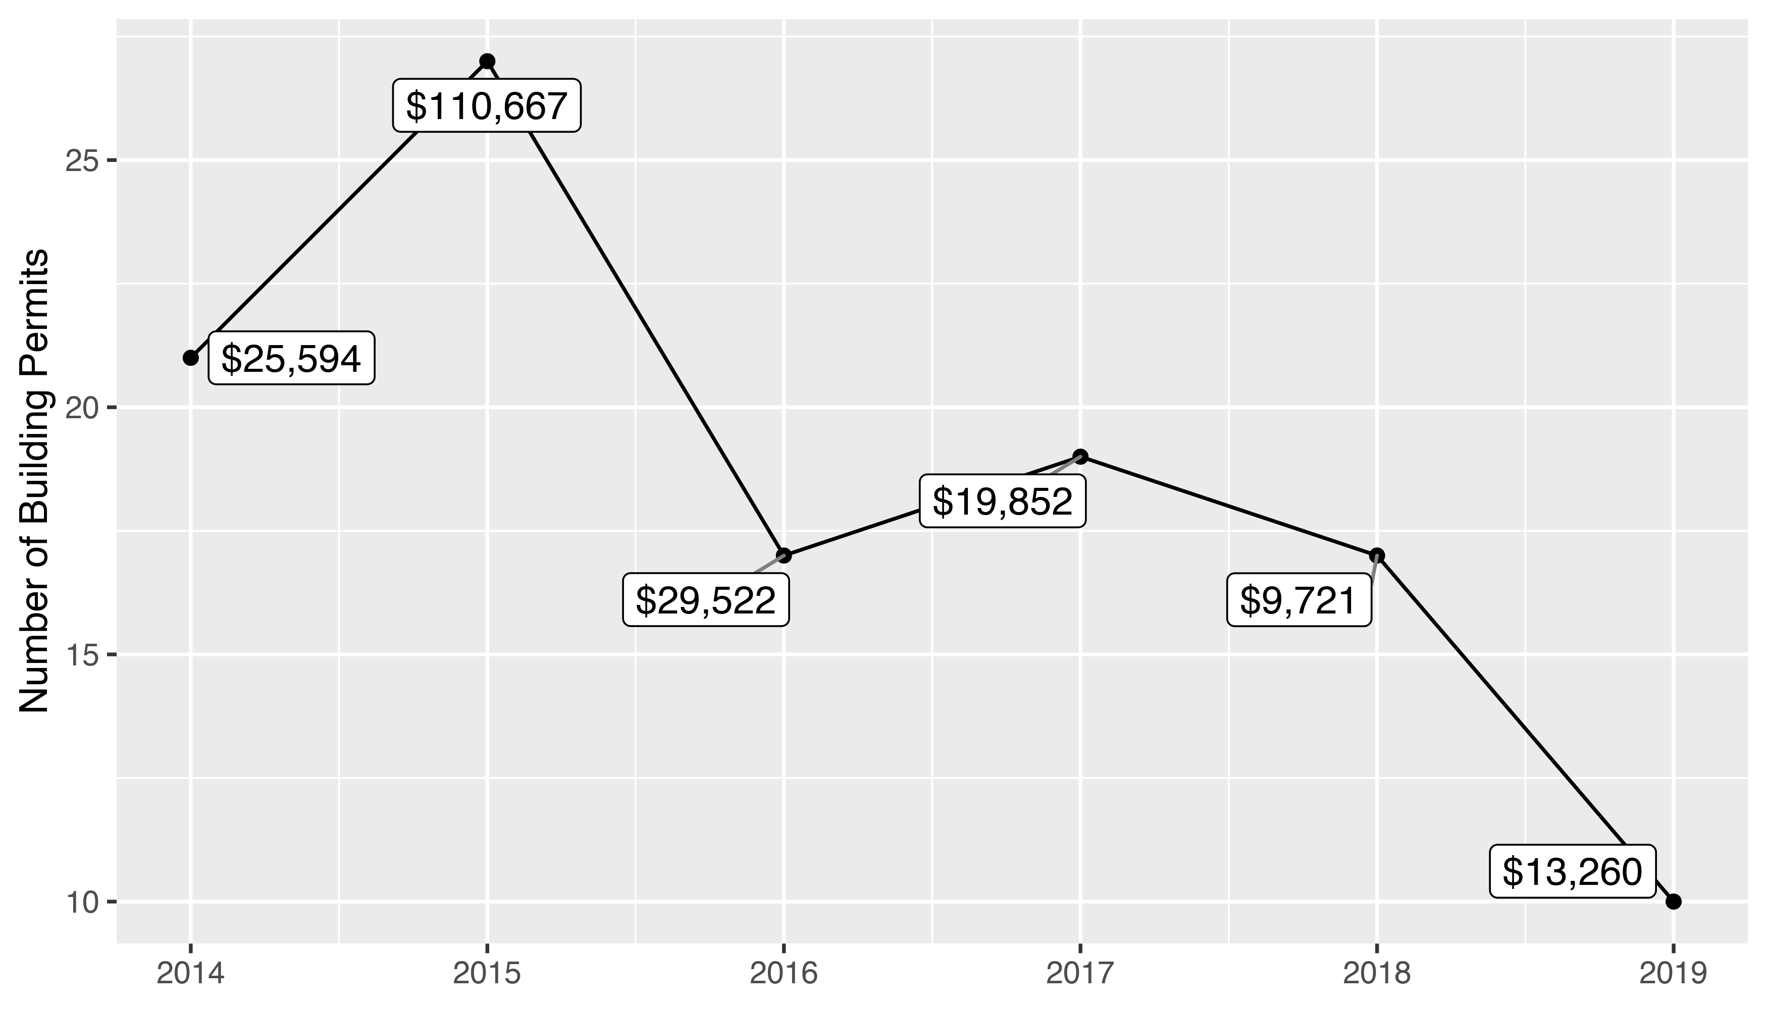
Lewis Place 5 Year Analysis

Slide 32
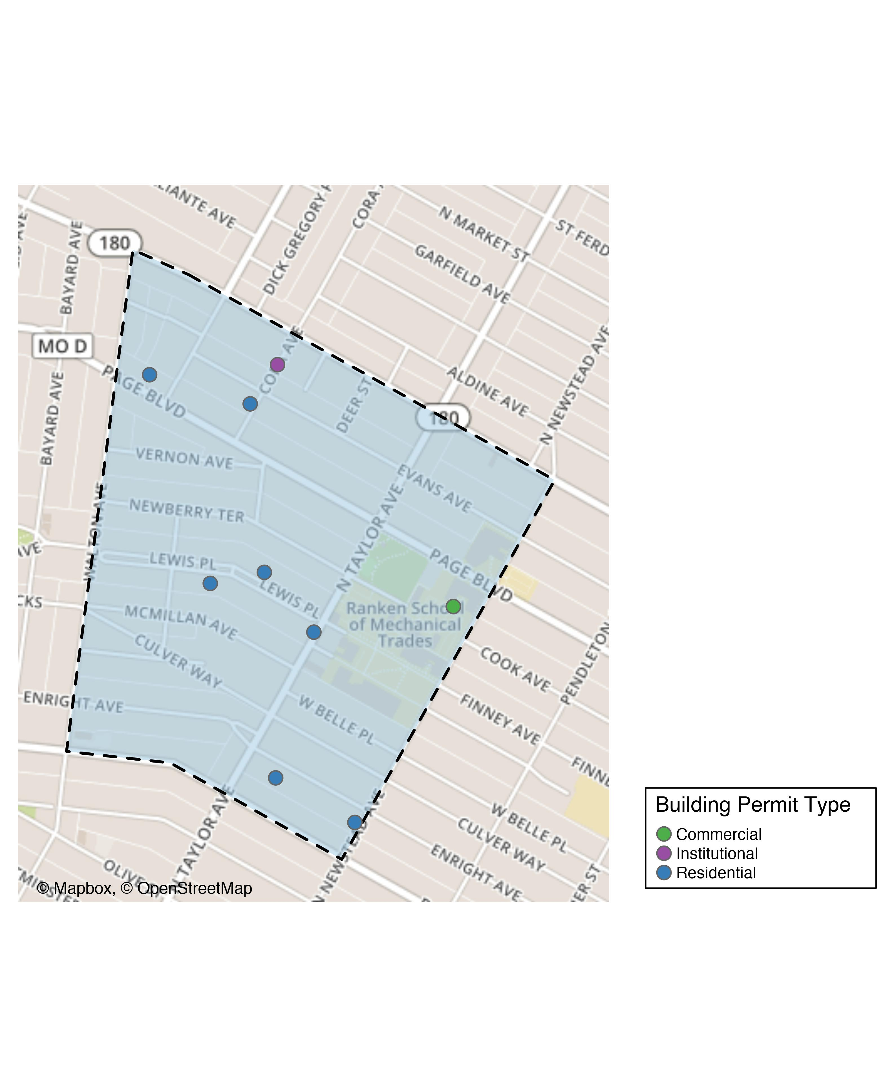
Lewis Place

Slide 33
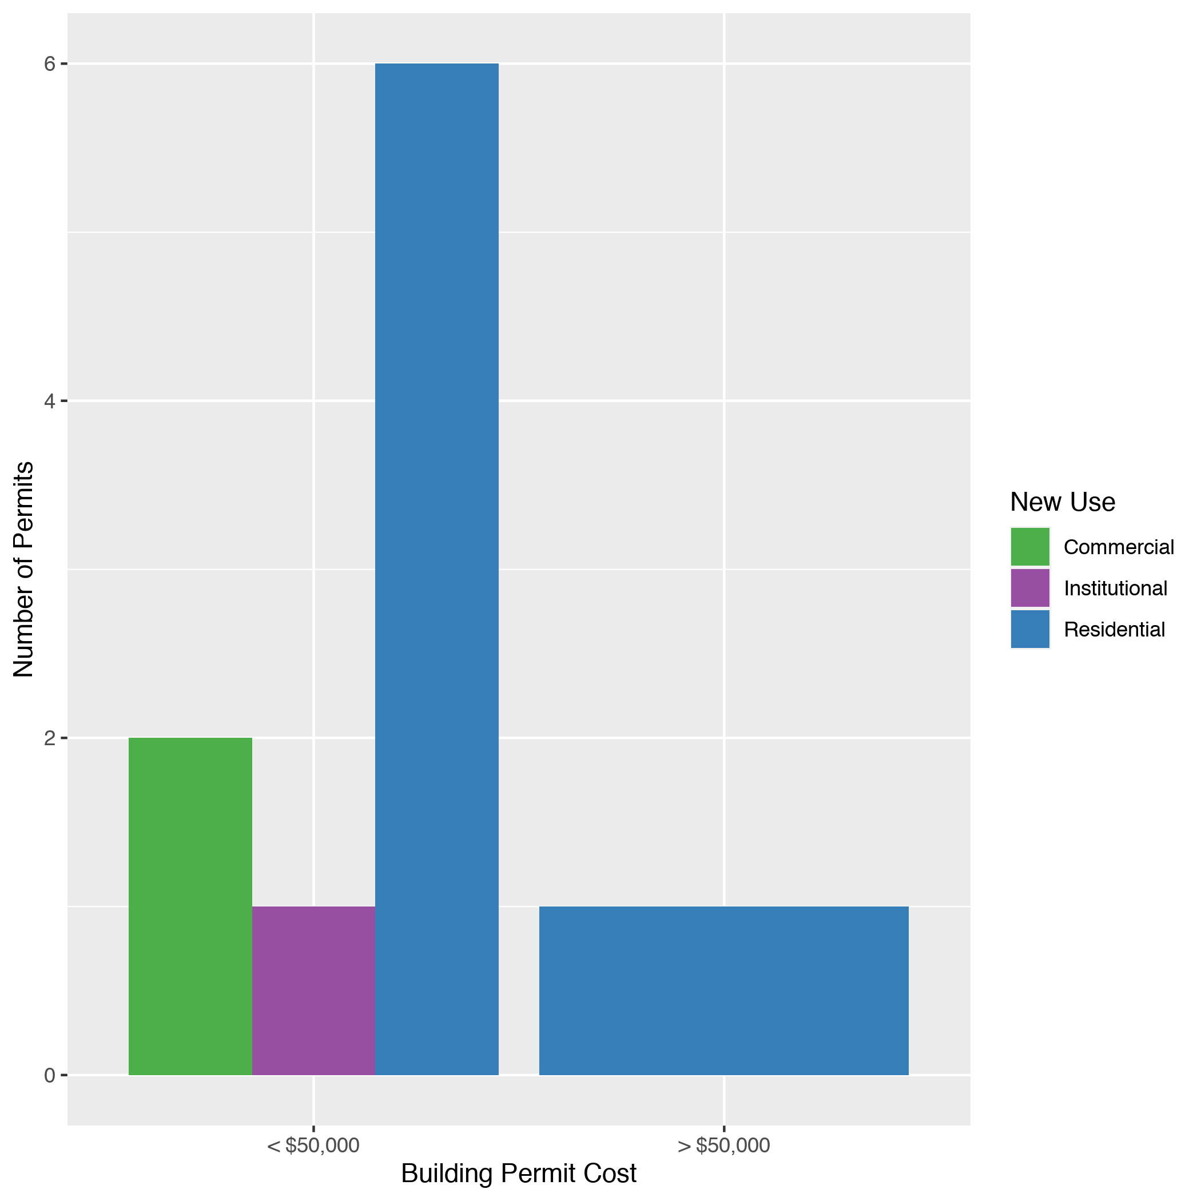
Lewis Place
New Use | Average Cost | # of Permits
Commercial | $15,000 | 2
Institutional | $20,000 | 1
Residential | $11,800 | 7

Slide 34
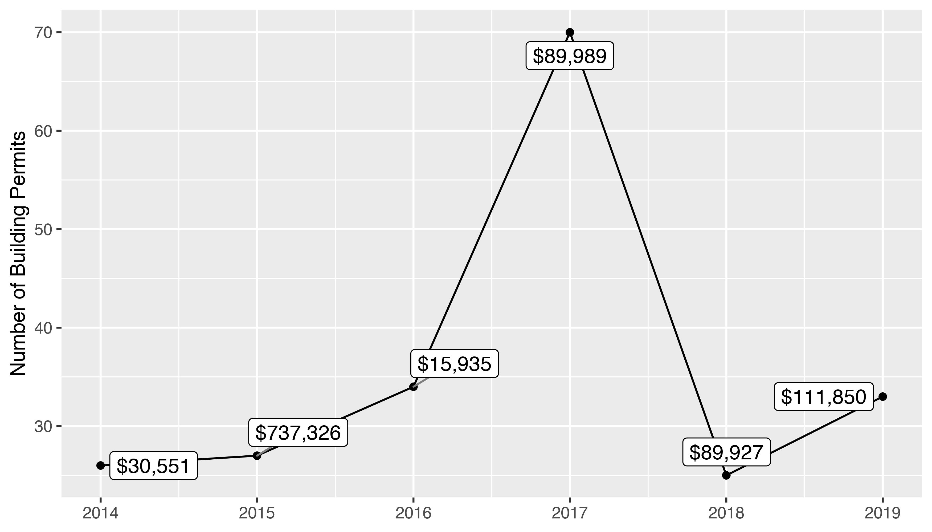
Vandeventer 5 Year Analysis

Slide 35
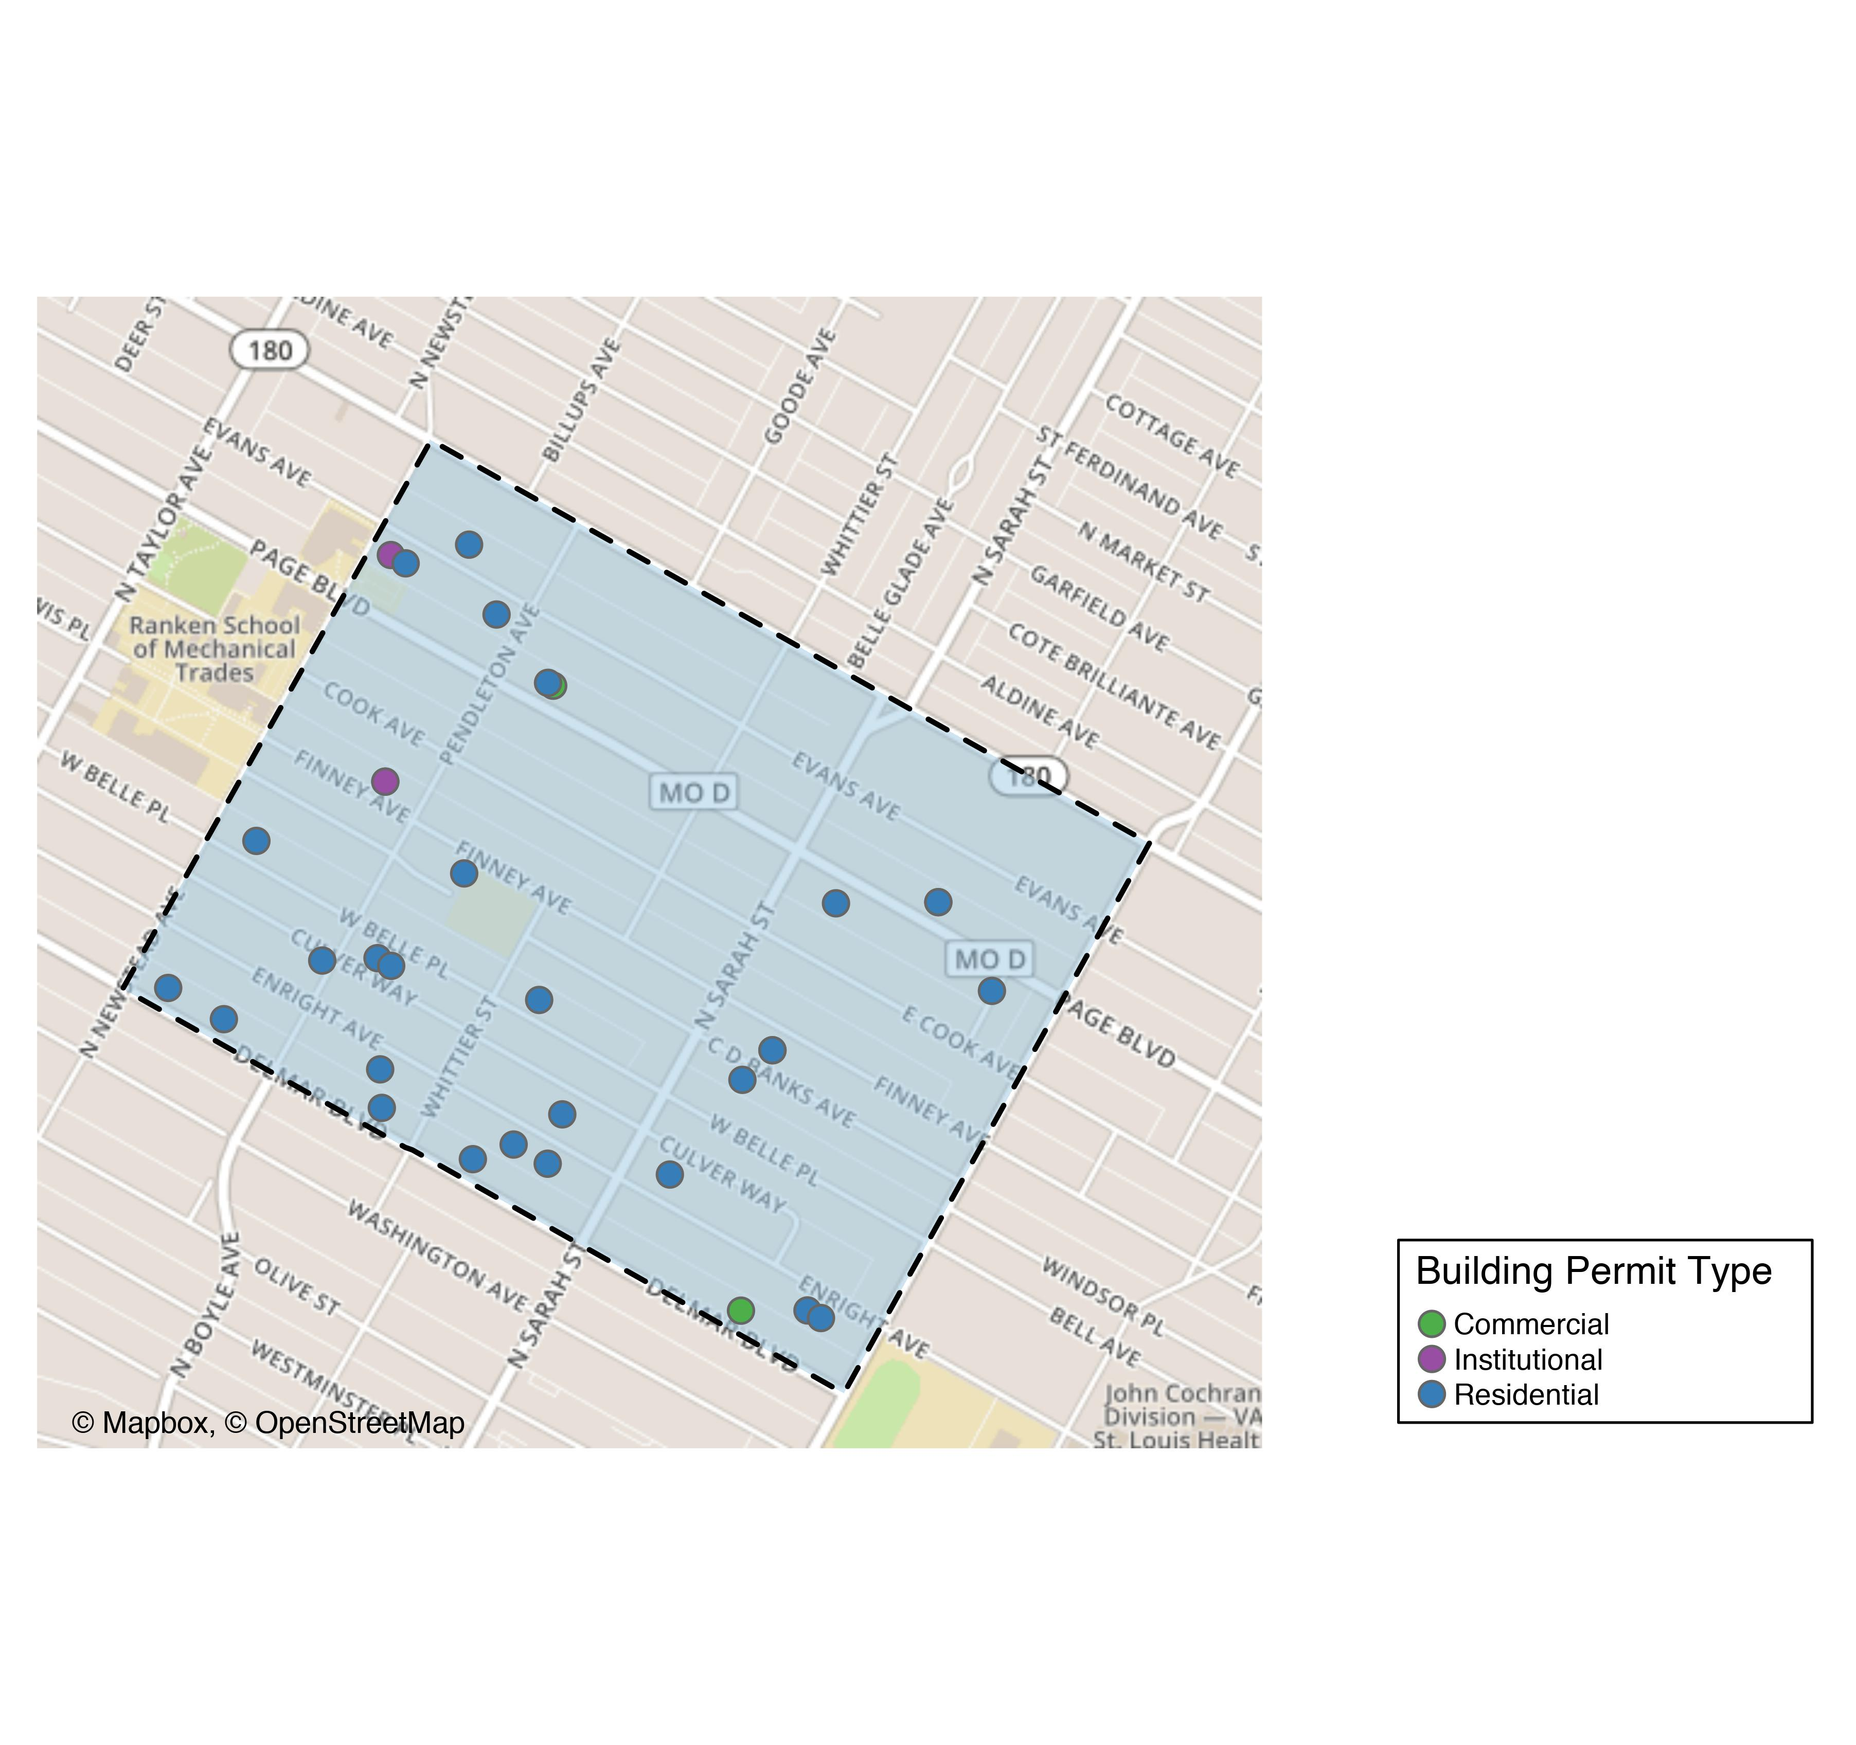
Vandeventer

Slide 36
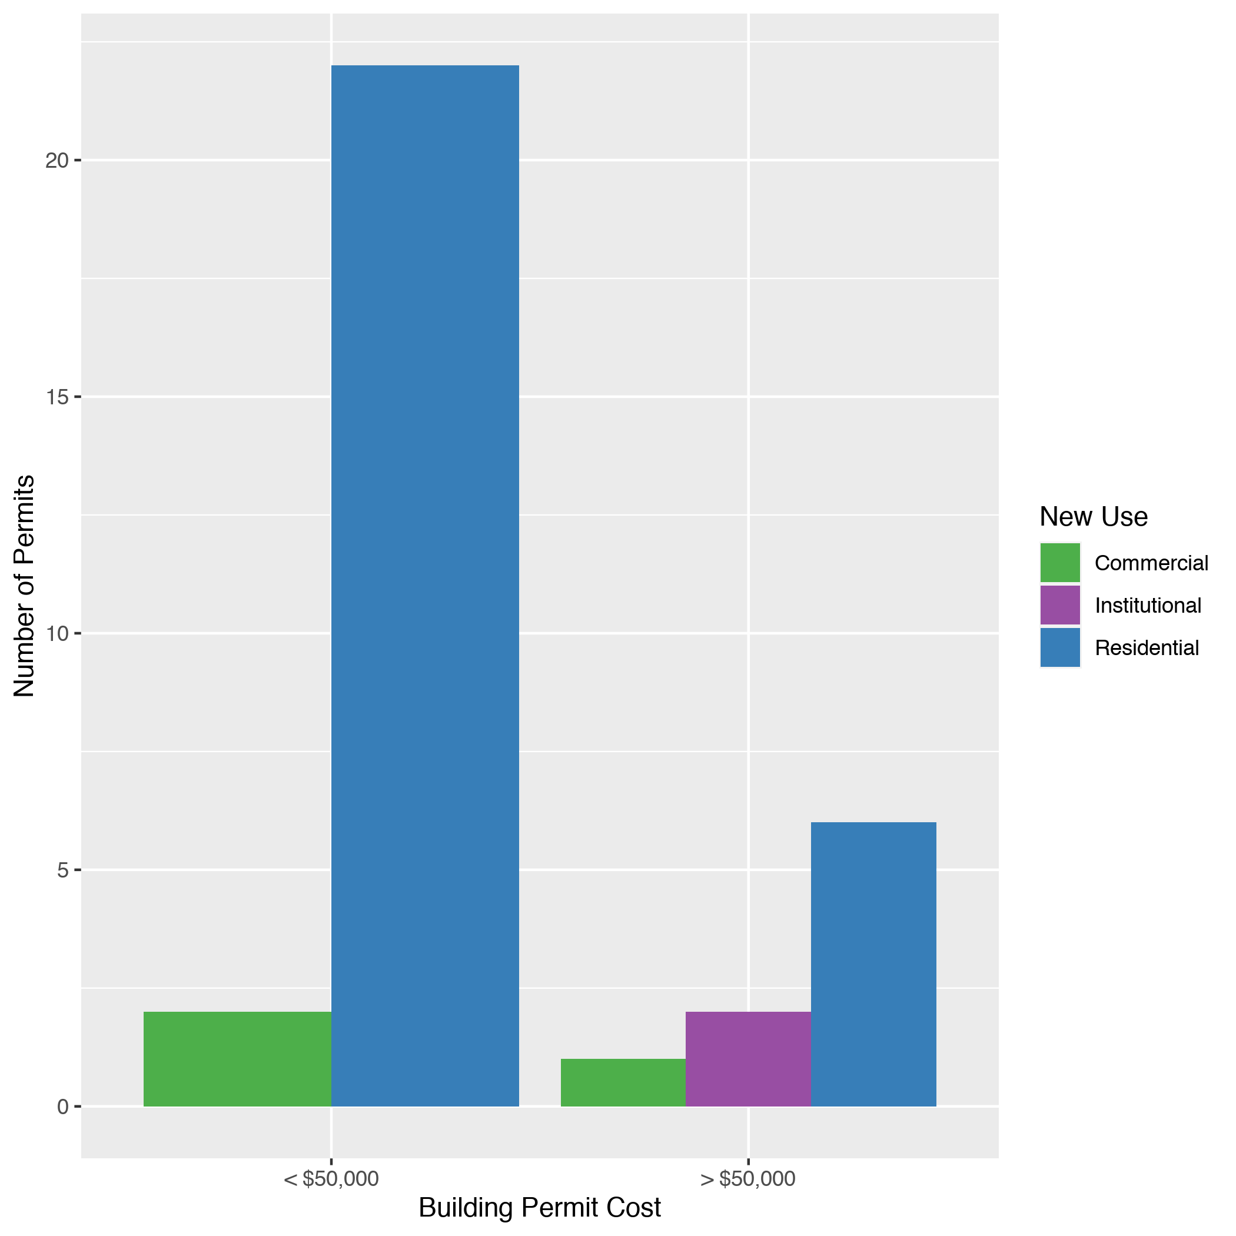
Vandeventer
New Use | Average Cost | # of Permits
Commercial | $919,215 | 3
Institutional | $82,500 | 2
Residential | $27,443 | 28

